Slide 1
our quest for Autonomous thinkers
Stokhof, De Vries, Bastiaens & Martens

Slide 2
Introduction by video

Slide 3
Why ?

Slide 4
Questioning supports autonomous learning
Notes:
asking questions is powerful heuristic for young childeren to explore and understand the world
afbeelding verkregen op 30-10-2016 van:
http://www.wugafriends.org/2016/09/the-more-we-look-worse-it-gets.html
https://www.babble.com/kid/i-thought-this-day-would-never-come-my-daughter-is-starting-to-ask-questions/
http://newcastleadvertiser.co.za/79138/ten-awkward-questions-children-ask-their-parents/
http://maxlifeproject.com/mind/open-your-mind-to-change/
http://playborhood.com/2008/02/creating_future_environmentalists_let_them_play_in_the_woods-2/

Slide 5
Notes:
asking questions is powerful heuristic for young childeren to explore and understand the world
afbeelding verkregen op 30-10-2016 van:
http://www.wugafriends.org/2016/09/the-more-we-look-worse-it-gets.html
https://www.babble.com/kid/i-thought-this-day-would-never-come-my-daughter-is-starting-to-ask-questions/
http://newcastleadvertiser.co.za/79138/ten-awkward-questions-children-ask-their-parents/
http://maxlifeproject.com/mind/open-your-mind-to-change/
http://playborhood.com/2008/02/creating_future_environmentalists_let_them_play_in_the_woods-2/

Slide 6
Notes:
asking questions is powerful heuristic for young childeren to explore and understand the world
afbeelding verkregen op 30-10-2016 van:
http://www.wugafriends.org/2016/09/the-more-we-look-worse-it-gets.html
https://www.babble.com/kid/i-thought-this-day-would-never-come-my-daughter-is-starting-to-ask-questions/
http://newcastleadvertiser.co.za/79138/ten-awkward-questions-children-ask-their-parents/
http://maxlifeproject.com/mind/open-your-mind-to-change/
http://playborhood.com/2008/02/creating_future_environmentalists_let_them_play_in_the_woods-2/

Slide 7
Multiple benefits of student questioning
Notes:
intrinsic motivation
relatedness
autonomy
competence
inquisitive stance
critical thinking
creativity
cognitive skills
metacognitive skills
etc
afbeeldingen verkregen op 30-10-2016 van:
https://www.odysseyware.com/blog/accelerated-learning-and-technology%C2%A0
https://uwaterloo.ca/centre-for-teaching-excellence/teaching-resources/teaching-tips/metacognitive
http://www.stanfield.com/blog/2012/09/letting-children-struggle-helps-develop-necessary-life-skills/
http://www.quotationof.com/creative-mind.html

Slide 8
inquisitive stance
Notes:
intrinsic motivation
relatedness
autonomy
competence
inquisitive stance
critical thinking
creativity
cognitive skills
metacognitive skills
etc
afbeeldingen verkregen op 30-10-2016 van:
https://www.odysseyware.com/blog/accelerated-learning-and-technology%C2%A0
https://uwaterloo.ca/centre-for-teaching-excellence/teaching-resources/teaching-tips/metacognitive
http://www.stanfield.com/blog/2012/09/letting-children-struggle-helps-develop-necessary-life-skills/
http://www.quotationof.com/creative-mind.html

Slide 9
Intrinsic motivation
Notes:
intrinsic motivation
relatedness
autonomy
competence
inquisitive stance
critical thinking
creativity
cognitive skills
metacognitive skills
etc
afbeeldingen verkregen op 30-10-2016 van:
https://www.odysseyware.com/blog/accelerated-learning-and-technology%C2%A0
https://uwaterloo.ca/centre-for-teaching-excellence/teaching-resources/teaching-tips/metacognitive
http://www.stanfield.com/blog/2012/09/letting-children-struggle-helps-develop-necessary-life-skills/
http://www.quotationof.com/creative-mind.html

Slide 10
Cognitive skills
Notes:
intrinsic motivation
relatedness
autonomy
competence
inquisitive stance
critical thinking
creativity
cognitive skills
metacognitive skills
etc
afbeeldingen verkregen op 30-10-2016 van:
https://www.odysseyware.com/blog/accelerated-learning-and-technology%C2%A0
https://uwaterloo.ca/centre-for-teaching-excellence/teaching-resources/teaching-tips/metacognitive
http://www.stanfield.com/blog/2012/09/letting-children-struggle-helps-develop-necessary-life-skills/
http://www.quotationof.com/creative-mind.html

Slide 11
Critical thinking
Notes:
intrinsic motivation
relatedness
autonomy
competence
inquisitive stance
critical thinking
creativity
cognitive skills
metacognitive skills
etc
afbeeldingen verkregen op 30-10-2016 van:
https://www.odysseyware.com/blog/accelerated-learning-and-technology%C2%A0
https://uwaterloo.ca/centre-for-teaching-excellence/teaching-resources/teaching-tips/metacognitive
http://www.stanfield.com/blog/2012/09/letting-children-struggle-helps-develop-necessary-life-skills/
http://www.quotationof.com/creative-mind.html

Slide 12
Creativity
Notes:
intrinsic motivation
relatedness
autonomy
competence
inquisitive stance
critical thinking
creativity
cognitive skills
metacognitive skills
etc
afbeeldingen verkregen op 30-10-2016 van:
https://www.odysseyware.com/blog/accelerated-learning-and-technology%C2%A0
https://uwaterloo.ca/centre-for-teaching-excellence/teaching-resources/teaching-tips/metacognitive
http://www.stanfield.com/blog/2012/09/letting-children-struggle-helps-develop-necessary-life-skills/
http://www.quotationof.com/creative-mind.html

Slide 13
How ?

Slide 14
Notes:
asking questions is powerful heuristic for young childeren to explore and understand the world
afbeelding verkregen op 30-10-2016 van:
http://www.wugafriends.org/2016/09/the-more-we-look-worse-it-gets.html
https://www.babble.com/kid/i-thought-this-day-would-never-come-my-daughter-is-starting-to-ask-questions/
http://newcastleadvertiser.co.za/79138/ten-awkward-questions-children-ask-their-parents/
http://maxlifeproject.com/mind/open-your-mind-to-change/
http://playborhood.com/2008/02/creating_future_environmentalists_let_them_play_in_the_woods-2/

Slide 15
support for effective questioning?
Notes:
afbeelding verkregen op 30-10-2016 van:
http://leocuijpers.blogspot.nl/2016/03/de-balans-halverwege-de-periode.html

Slide 16
Design Based research
Notes:
intrinsic motivation
relatedness
autonomy
competence
inquisitive stance
critical thinking
creativity
cognitive skills
metacognitive skills
etc
afbeeldingen verkregen op 30-10-2016 van:
https://www.odysseyware.com/blog/accelerated-learning-and-technology%C2%A0
https://uwaterloo.ca/centre-for-teaching-excellence/teaching-resources/teaching-tips/metacognitive
http://www.stanfield.com/blog/2012/09/letting-children-struggle-helps-develop-necessary-life-skills/
http://www.quotationof.com/creative-mind.html

Slide 17
Developing a scenario
Linking theory to practice, and practice to theory
Various perspectives, multiple roles

Slide 18
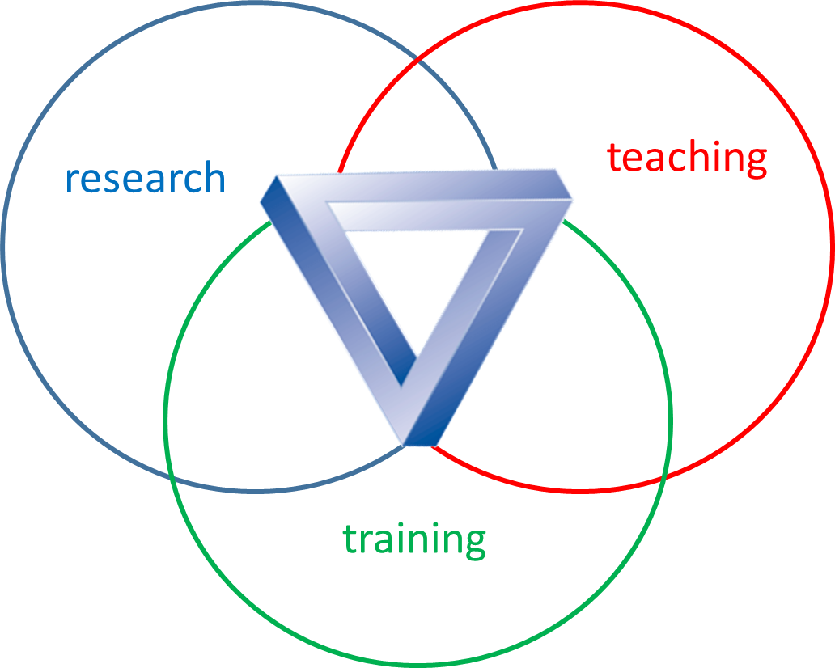
Developing a scenario
Linking theory to practice, and practice to theory
Various perspectives, multiple roles
Notes:
afbeelding puzzelstukjes vervallen: verkregen op 30-10-2016 van:
http://www.bethelzorg.nl/

Slide 19
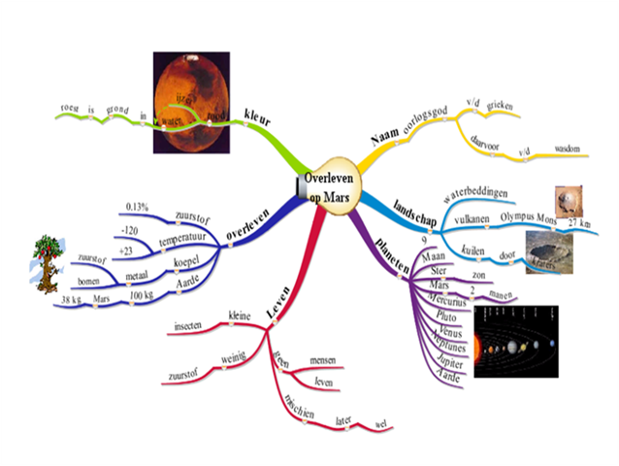
Phase 1 | Phase 2 | Phase 3 | Phase 4 | Phase 5
Preparation | Introduction | Questioning | Knowledge construction | Evaluation
Core curriculum introduction Elict questions Resources | Inventory of collective & individual prior knowledge | generate formulate adopt | Answer questions Building collective knowledge | knowledge (meta) cognitive skills
Expert mind map | Classroom & student mind map | Classroom mind map | Classroom mind map | Classroom & student mind map
Notes:
these are the 5 phases of our scenario to help teachers guiding effective student questioning
one of the main design principles is to visualize the questioning process in every phase, for which we use mind mapping

Slide 20
PrototypE I
Notes:
in its present form the scenario was developed in multiple iterations of design, implementation, analysis and redesign

Slide 21
Prototype II
Notes:
in four years we developed four prototypes

Slide 22
Prototype III
Notes:
in each prototype problems were identified for which we tried to design solutions

Slide 23
Prototype IV
Notes:
and those solutions were tested and evaluated in the next prototype

Slide 24
Examples

Slide 25
Example 1 inventory prior knowledge
Notes:
In phase two the pupils are introduced to the topic and the aim is to elit their prior knowledge and motivation to learn more

Slide 26
Trigger / PromPt
Notes:
we do this by presenting pupils a trigger or prompt which could be
a bar of chocolate as in the workshop.

Slide 27
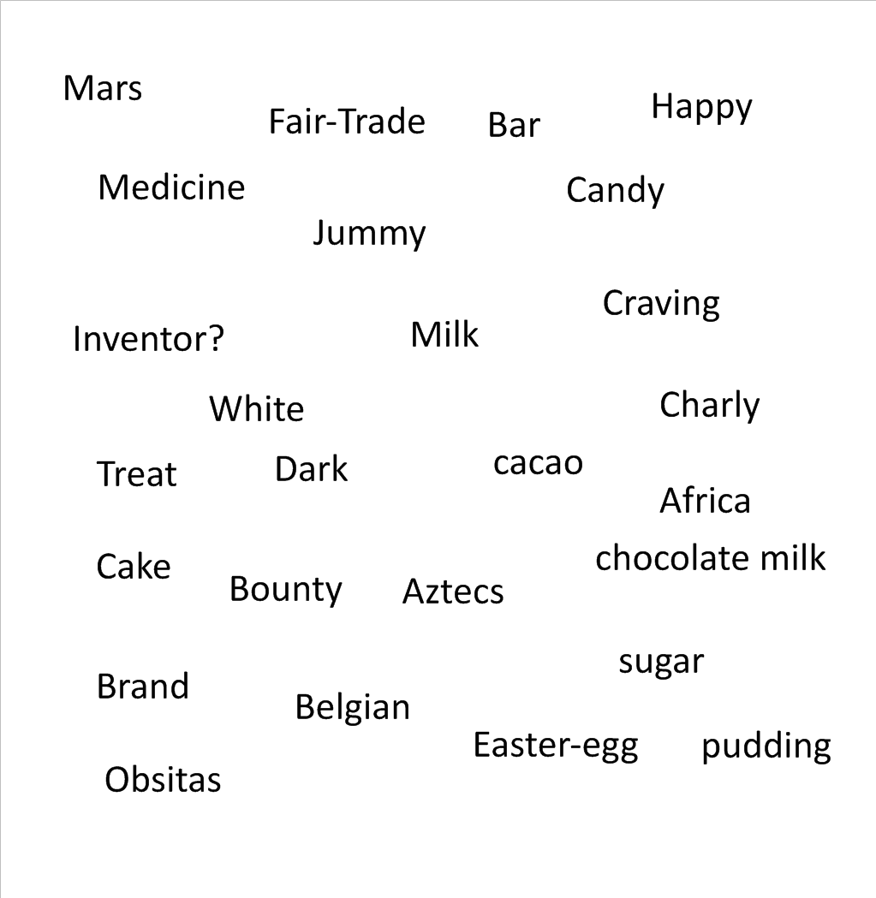
Field of words
Notes:
pupils first record their associations individually and then share them in groups in to a field of words

Slide 28
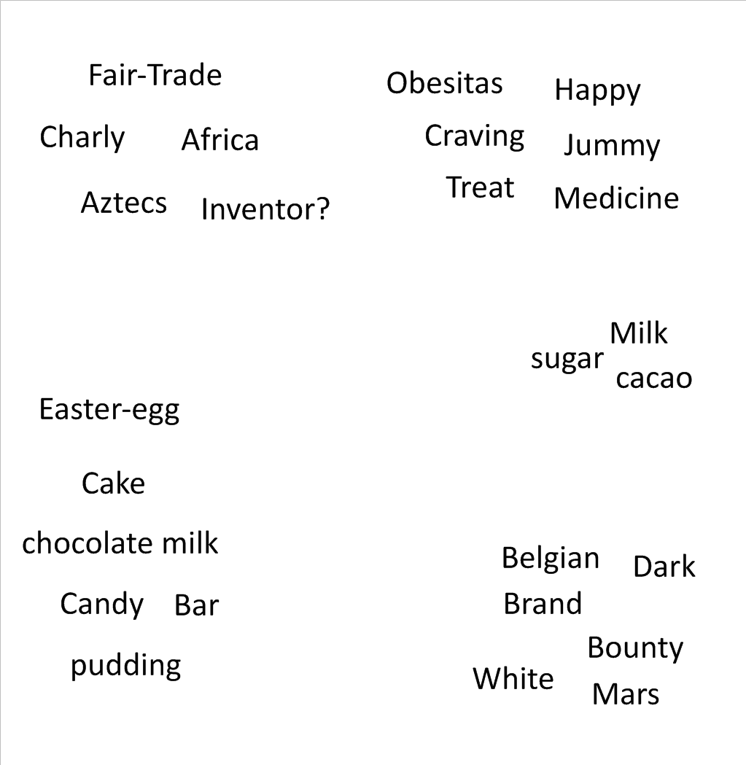
Words Cluster
Notes:
in most groups pupils will automatically will see connections between concepts and will cluster them or will do so when instructed

Slide 29
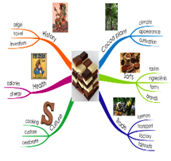
Classroom Mind map
Notes:
the clusters can be structured even further by making mind map branches show which concepts are key concepts, sub concepts , details or examples

Slide 30
Activitating prior knowledge
Problem in protype I
* too many (non-relevant) concepts
* lack of focus
* time-consuming process

Slide 31
Activitating prior knowledge
Problem
Solution prototype II
* too many (non-relevant) concepts
* lack of focus
* time-consuming process
use of key concepts

Slide 32
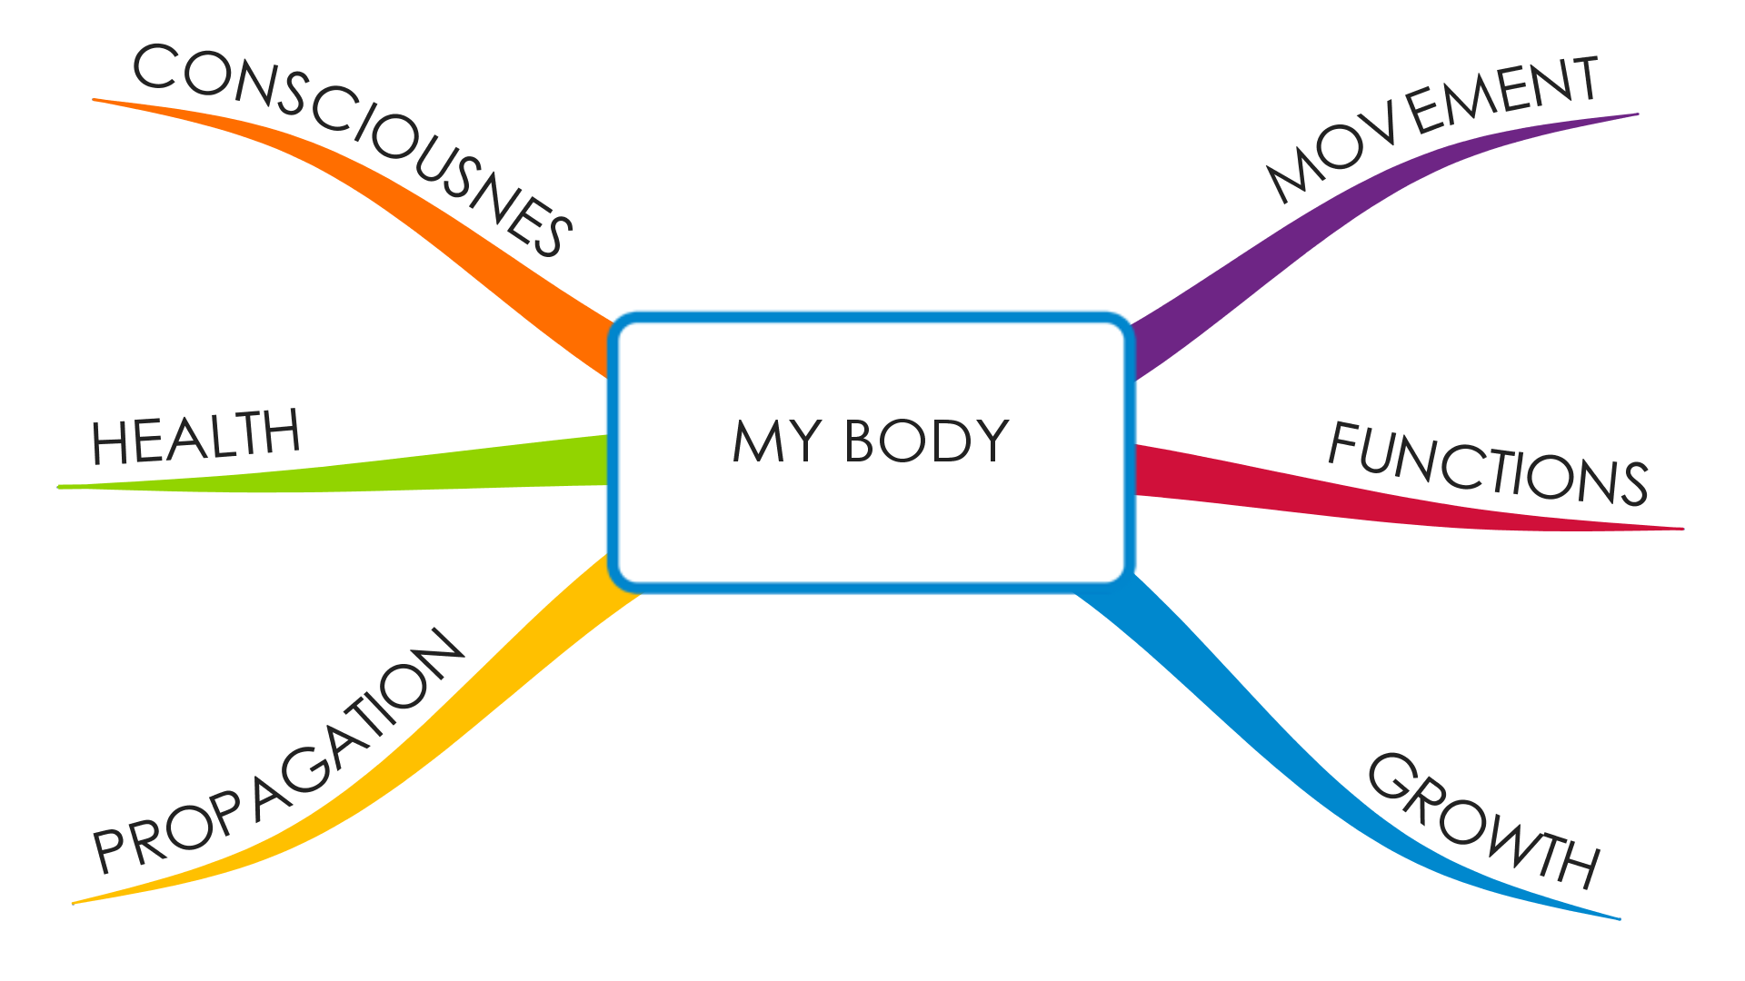
Activitating prior knowledge
Problem
Solution prototype II
* too many (non-relevant) concepts
* lack of focus
* time-consuming process
use of key concepts
Notes:
solution: use of key concepts to activate prior knowledge
example of key concepts for “My Body” in Grade 4-6:

Slide 33
Example 2 Guiding questions
Notes:
the second example I would like to show you became evident in prototype II

Slide 34
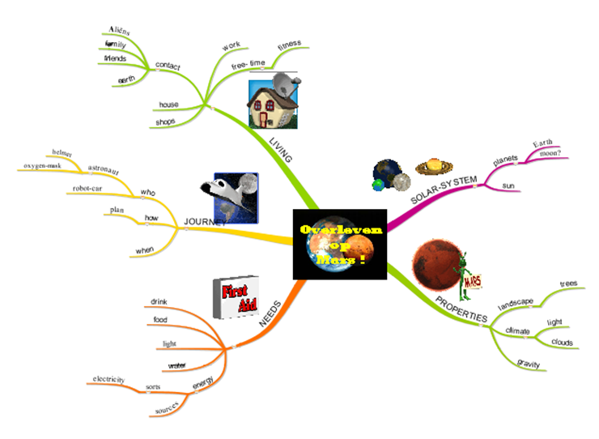
Students’ Eagerness to investigate
Problem prototype II
* questions require mediation
* need simultaneous attention
* tendency: 1-on-1 guidance
?
?
?
?
?
?
?
?
?
?
Notes:
challenge:
students are eager to ask questions
want to investigate as soon as possible
problem:
initial questions require mediation
many questions need simultaneous attention
one-on-one guidance is impossible

Slide 35
Students’ eagerness to investigate
Problem prototype II
Solution prototype III
* questions require mediation
* need simultaneous attention
* tendency: 1-on-1 guidance
revised “question- formulating technique”

Slide 36
Students’ eagerness to investigate
Solution prototype III
revised “question formulating technique”
Notes:
(Rothstein & Santana, 2011)

Slide 37
impact

Slide 38
Transfer to new contexts
Notes:
image retrieved on 19-11-2016 from:
http://mediaroom.marlinfinance.com/information-technology-equipment/artificial-intelligence-how-context-rich-systems-will-tell-it-more-about-everything/

Slide 39
more schools
Notes:
more than 20 primary schools
Secondary schools
Vocational schools

Slide 40
teacher education
Notes:
pre-service teachers
in-service teachers
teacher-educators
global citizenship education

Slide 41
research
Notes:
PhD- implementation studies
at least 50 Bachelor students who have been involved in some form of research related to the scenario
Even some Master students from other universities have become involved

Slide 42
curriculum development
Notes:
Teachers College
Professional Development Schools

Slide 43
A big thank you to:
HAN University of Applied Sciences- Research Centre for Quality of Teaching and Learning
Bregje de Vries, Loek Nieuwenhuis, Annelies Dickhout
Open University, Heerlen & FernUniversität, Hagen
Theo Bastiaens, Rob Martens
HAN University of Applied Sciences- Teachers College for Primary Education
Karin van Weegen, Diana Prins, Peter Fransen, Dannie Wammes
Students
Jasmijn van Benthum (and many more....)
Primary Schools
De Lanteerne & De Esdoorn

Slide 44
More information? harry.Stokhof@han.nl www.han.nl/kwaliteitvanleren

