Slide 1
Teacher support for guiding effective student questioning in question-driven learning
A principle based-scenario for question-driven education
Dr. Harry Stokhof
International Hatenathon Forum, Kyoto, Japan

Slide 2
dr. Harry Stokhof Nijmegen, The Netherlands, Europe
1995-
2007
2012-
2017
Primary School Teacher
PhD research project
2007-
present
2019-
2021
Teacher Educator
Researcher
Educational Designer
How to support teachers in guiding effective student questioning?
Post-doc research project

Slide 3
What is question-driven learning?
Question- driven
learning
Students’
questions
Inquiry-based
learning
Question-driven Learning (QDL)
is a specific open form of Inquiry Learning in which students formulate and investigate their own questions, and these questions form the heart of the curriculum
(Chin & Chia, 2004; Scardamalia & Bereiter, 1992; Shodell, 1995; Wells, 2001).

Slide 4
Why is student questioning important?
Increases intrinsic motivation for learning (Chin & Osborne, 2008; Deci & Ryan)
Connects learning to prior knowledge (Palincsar & Brown, 1984)
Supports deep and meaningful learning (Rosenshine, Meister & Chapman, 1996).
Develops metacognitive strategies (Chin & Osborne, 2008 ; Scardamalia & Bereiter, 1992)
Elicits creative thinking (Keys, 2002; Scardamalia & Bereiter, 1992)
Relevant for Science, Literacy, Numeracy, Arts (Allmond & Makar, 2010; Gillispie,1990; Osborne & Dillon, 2008).
LEARNING

Slide 5
Present state of student questioning
Teachers ask 95% of all questions in class.
Teacher questioning stifles student questioning.
Students give answers, but seldom ask questions.
A lot of student question potential remains unused.

Slide 6
Teachers as change agents
Teachers have powerful potential
to support change
(Fullan, 2012)
Lasting change in education
depends on teachers
(Yoshioka, Matsumoto, & Fulton, 2017)

Slide 7
Teachers seek the balance
opportunity
for student
questioning?
attaining
learning
outcomes?
How to guide effective student questioning?

Slide 8
Teachers’ challenges
DESIGN?
Select curriculum goals?
Anticipate on student questioning?
GUIDE?
Classroom management?
Optimalise learning outcomes?
Build collective knowledge?
EVALUATE?
Measure individual progress?
Assess curriculum goals?

Slide 9
Design-based research to develop support
Five years: 2012-2017
Develop solution
Prototyping
5 iterative cycles
Participatory design
12 teachers
2 primary schools

Slide 10
A series of four studies
RESEARCH QUESTION | TYPE OF STUDY
What is already known? | Literature review
Solution for teachers? | Development study
Effect on students? | Effect study
Transfer to other schools? | Implementation study

Slide 11
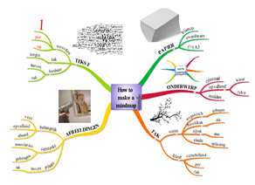
Four principles for teacher guidance
1
2
3
4
acknowledge learning
potential in questions
provide conceptual
focus for questioning
organize collective responsibility
visualize the
questioning process

Slide 12
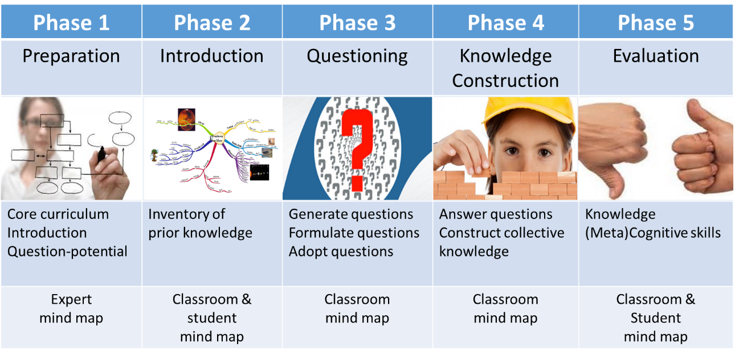
Five Phase Scenario for support

Slide 13
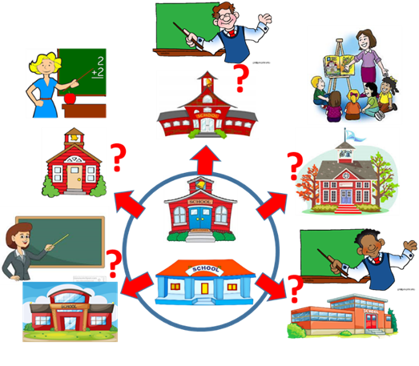
Results for teachers
Support perceived as:
Relevant
Practical
Effective
Willingness to continu use:
80% of 103 teachers- very willing
Independent of teacher or school characteristics

Slide 14
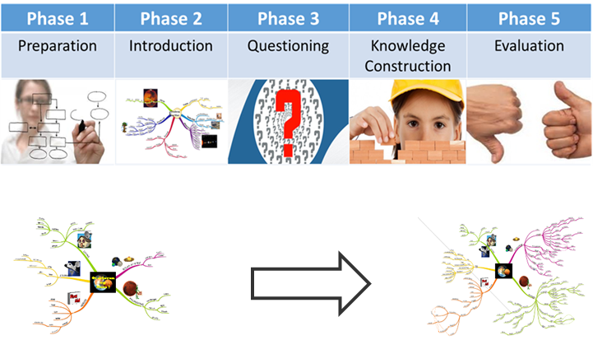
Results for students
SHORT TERM EFFECTS
Learn core curriculum
Extend knowledge
Refine knowledge structures
LONG TERM EFFECTS
Highly motivated to learn
Develop metacognitive skills
Prepared for life-long learnig

Slide 15
Transfer to other educational contexts
Teacher Education
As content
As teaching strategy for teacher educators
Higher and Vocational Training
To bridge gap between practice and theory
School teams
To support teacher participation in school development

Slide 16
Future developments
Scaling-up implementation
New schools: from 35 to 150 primary schools
New sectors: secondary education & university
New applications: use in non-educational settings
Follow-up research
How support teacher development
Scaffold the “the road from questions to answers”
Interested in international collaboration
Curious how to support student questions in other educational systems
Open for international collaboration in further development

Slide 17
Recommendations for Japanse teachers
Develop a shared vision
Discuss: What should be the benefits of QDL for our students?
Discuss: What does QDL require from us as teachers?
Organize collective support
Prepare collectively
Evaluate collectively
Practice to become role model
Develop your own inquisitive stance
Explore the possibilities to use parts of scenario
See the scenario as modulair and flexible
The principes are guidelines: feel free to adapt scenario to local needs and concerns
Experiment with application of 4 principles

