Slide 1
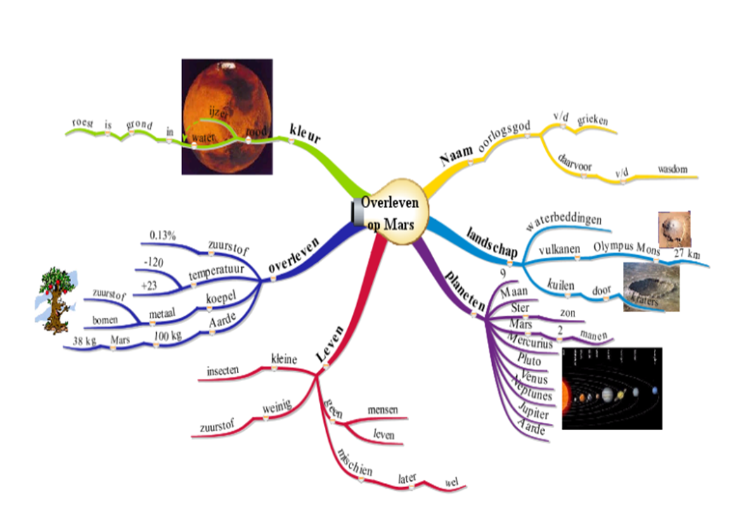
DYNAMIND
Fostering Inquiry Based Learning by Digital Mind Maps
Harry Stokhof
Ed van Uden

Slide 2
DYNAMIND
Research questions and method
Research questions and design
QUESTIONS
How can Digital Mind Maps (DMM) support Inquiry Based Learning (IBL)?
a. What are the effects of DMM on motivation and learning of pupils?
b. Does DMM support teachers in designing, implementing and evaluating IBL?
Research questions and design:
METHODE
Quasi-experimental design:
METHOD
- 2 schools, 12 teachers, 271 pupils
- experimental and control groups
- pre-, post- and retention tests
- quantitative en qualitative analysis

Slide 3
DYNAMIND
Research questions and method
Population:
school
A: Esdoorn
B: Laurentiushof
Chocolate
Mission
to Mars
Province:
Gelder
Continent:
Oceania
theme
POPULATION
group
5-6
7-8
5-6
7-8
condition
X
C
X
C
X
C
X
C
classes
1
1
1
2
2
1
2
1
pupils
24
27
23
52
47
22
51
25

Slide 4
DYNAMIND
Research questions and method
Research instruments:
INSTRUMENT
BASED UPON
VARIABLES
Questionnaire
Teachers
Research IBL
(Stokhof,
De Vries 2009)
motivation; design-
implement- and
evaluation competence
Questionnaire
Pupils
IMI (Deci, Koestner,
Ryan, 1991) R-SPQ-F2
(Biggs, 2001)
intrinsic motivation
and learning strategies
INSTRUMENTS
Mind Map
Analysis
Instrument
Conceptmap analysis
research (Beyerbach,
1990; Buzan, 1995; Novak,
2002; Merchie, 2009;
Koopmans, 2010)
quality of learning:
learning outcomes
Interviews
Teachers
Research IBL
(Stokhof,
De Vries 2009)
motivation; design-
implement- and
evaluation competence

Slide 5
and now ....
What happened in the classroom?
The story of...
The primary school:

Slide 6
DYNAMIND
Research questions and method
Researching Mindmaps: how to assess learning outcomes?
Categories:
Variables:
Measure:
Concept placed on branch
Surveyability
Readability of text
4-point Likert-scale
Splitting at end of branch
Quantity of
Concepts
Number of concepts
in mindmap
number
Quality of
Concepts
Reproduction of Basis Concepts
Added Concepts
4-point Likert-scale
Degree of Hierarchy
Repetition of Concepts
Quality of
Images
presence of images
sum score of 3 variables
number of images
4-point Likert-scale
relevance of images

Slide 7
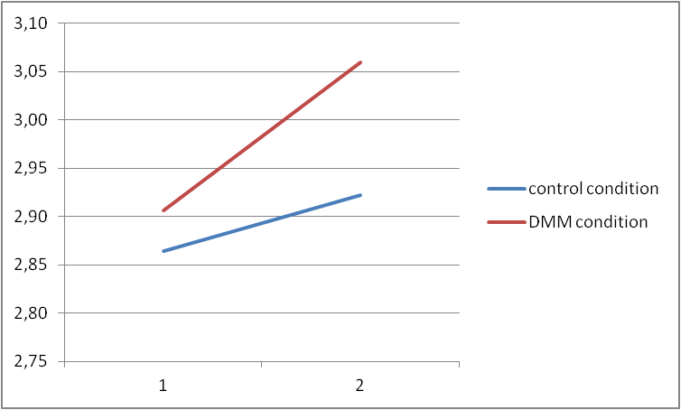
DYNAMIND
Research questions and method
Results pupils: motivation

Slide 8
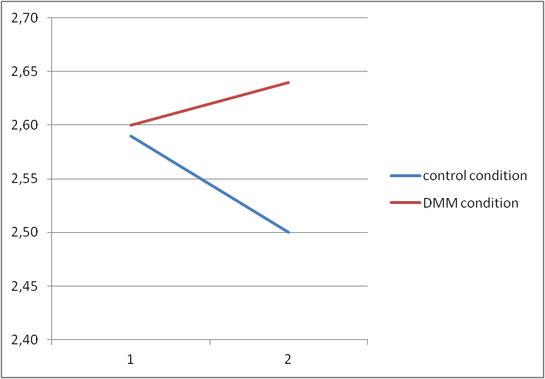
DYNAMIND
Research questions and method
Results pupils: learning strategies

Slide 9
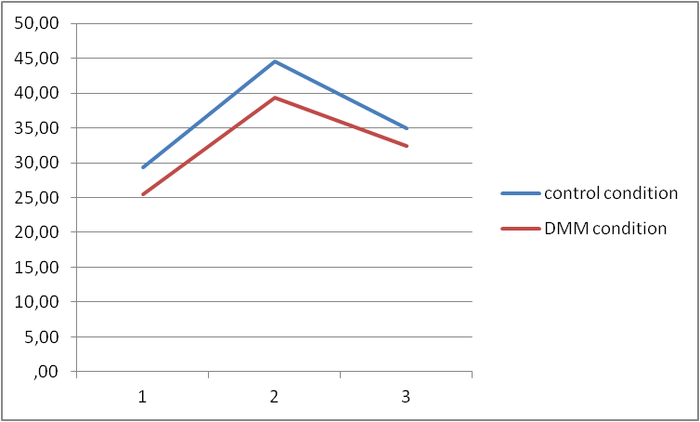
DYNAMIND
Research questions and method
Results pupils: number of concepts in mindmap

Slide 10
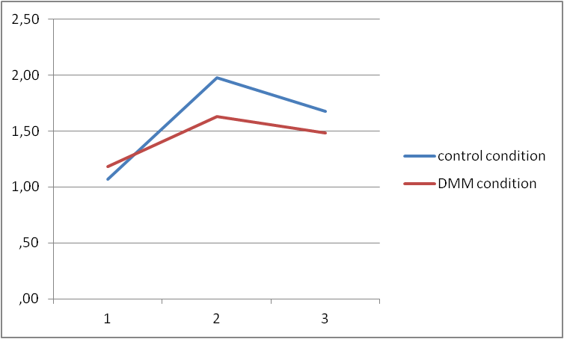
DYNAMIND
Research questions and method
Results pupils: quality of concepts in mind map (1)
Similarity to
Expert map =
Reproduction of
Basis Concepts

Slide 11
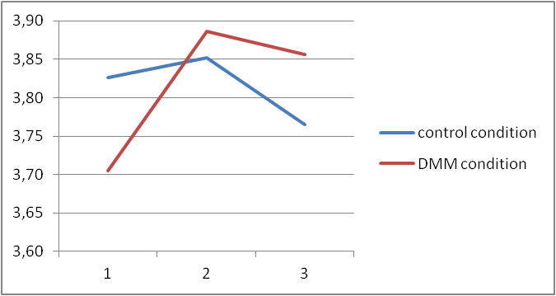
DYNAMIND
Research questions and method
Results pupils: quality of concepts in mind map (2)
Dissimilarity to
Expert Map =
Added Concepts
by IBL

Slide 12
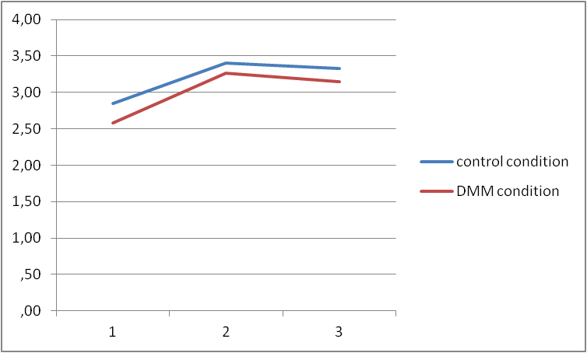
DYNAMIND
Research questions and method
Results pupils: quality of concepts in mind map (3)
Degree of hierarchy
in mindmap

Slide 13
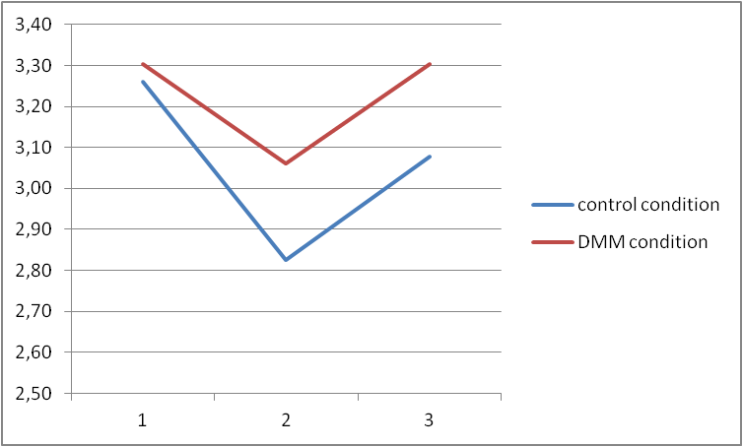
DYNAMIND
Research questions and method
Results pupils: repetition of concepts in mind maps

Slide 14
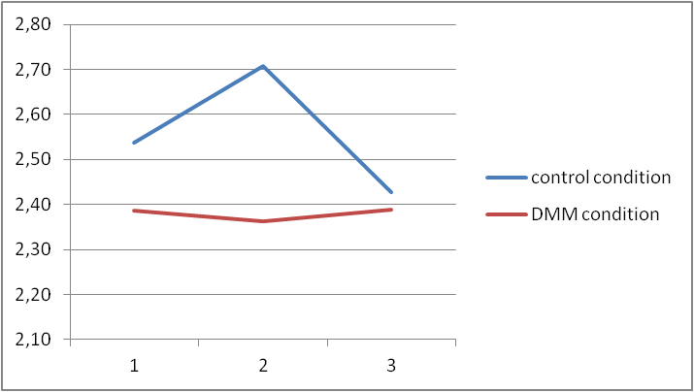
DYNAMIND
Research questions and method
Results pupils: quality of images

Slide 15
DYNAMIND
Research questions and method
Results Teachers: designing IBL using Mind Maps
'Exchanging our mindmaps made me see, how different our views were on the subject.'
'The Teachers' Mind Map helped me to focus on the goals, so I became less absorbed in the organization of the activities....'
'I didn't know what to expect of IBL, but working with the Teachers' Mind Map gave me confidence.'
'Because we all knew exactly in advance, what we wanted to achieve, there was less time needed for our preparation.'
'It was easier to keep an overview on various aspects of the subject, because we had prepared ourselves so thouroughly by means of the mindmap'

Slide 16
DYNAMIND
Research questions and method
Results Teachers: implementing Mind Maps in IBL
'The children love to make a mind map: They're really motivated.'
'The children saw an example and they could make their own mind map without difficulty.'
MOTIVATION
'They were open for new information and could process it really quickly'
'My pupils were very involved and participated eagerly in clustering the word cloud and building the classroom mind map.'
'The classroom mind map raised interest in new aspects of the subject.'
'It was helpful in formulating questions, to let the children pick a branch'
QUESTIONNS
'Questions were evolving because of the classroom mind map. Pupils used concepts out of it to make their questions more specific.'

Slide 17
DYNAMIND
Research questions and method
Results Teachers: implementing Mind Maps in IBL (2)
'Because of the structure of the mind maps children kept an overview on the various questions'
OVERVIEW
'The children were quickly aware, which questions were connected.'
'They could see, who was working on a similar question.'
'My pupils started to exchange information, concerning each others' questions, they found by chance.'
EXCHANGE
'Surfing the net, they found all kinds of information. Some wasn't necessarily relevant to their own question, but was relevant for the class room mindmap, so we added that info too.'
'They were really learning from each other, which was very nice to see.'

Slide 18
DYNAMIND
Research questions and method
Results Teachers: evaluating IBL by means of Mind Mapss
'The difference in quality is obvious at the first glance: some children have only 1 or 2 main branches and others have several layers of branches and sub branches.'
OUTCOMES
'I've the impression that making a mind map helps the children to retain the information.'
'Examining the mind maps, I discovered that main interest of the children was focussed on the solar system and not so much on the Mission to Mars.'
"He's always very involved, asking questions, giving answers, but I've not seen that in his mind map, I wonder why?'
CONSIDERATIONS
'I have the impression that I haven't reached the full potential of IBL,
but perhaps that was not yet possible. This was only the first step...'

Slide 19
DYNAMIND
Research questions and method
Conclusions: DMM or Mind Mapping on paper ?
'The digital mind map is easily made and adaptable on the IWB'
'I can link notes and websites to the branches in DMM'
'Working on paper is creative, but costs a lot of time, so next time I would choose DMM.'
PRO DMM
'In DMM I can save versions of the developing mind map, so I can see how it developed over time.'
'In future we would like to use the mind map to prepare our subjects, and then it is very convenient
to link our lessons, websites, documents and so on to the branches of the digital mind map.
It will save us time next time.'
'The big advantage of mind mapping on paper is, that children can work without the distractions they'll find on the computer.'
PRO PAPER
'A paper mind map is always visible during the day, for DMM you need the IWB.'
'Children, who like to draw and be creative should also make mind maps on paper.'
'I see advantages for both forms of mind mapping for the children, but being a teacher, I choose DMM'.

Slide 20
DYNAMIND
Research questions and method
Balancing workplace learning and practitioner research
Advantages for teachers:
Advantages for researchers:
co-designing education
raising research quality
'adressing authentic problems'
'tuning questions to practice'
'collaborative effort'
'maximum participation'
'high turn-out of data'
professional development teachers
'guarding the conditions'
'look at the big picture'
'mastering new skills'
relevant output
'discovering new needs'
'results for the classroom practice'
'results for Teachers' Training'
systematic evaluation
'results for Educational Sciences'
'testing innovative designs'
'goal awareness'

Slide 21
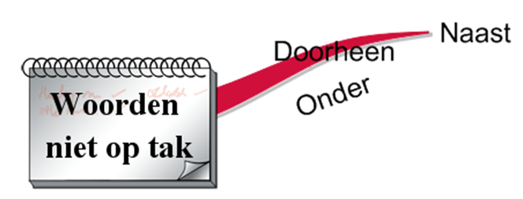
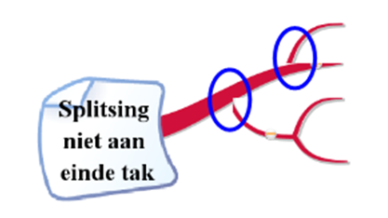
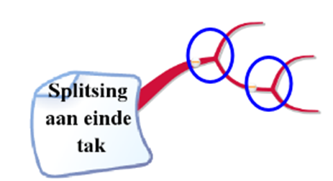
Concept placed on branch
BACK
Concept not
on branch
Concept on
branch
Readability of text
Splitting at end of branch

Slide 22
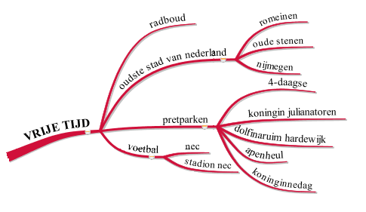
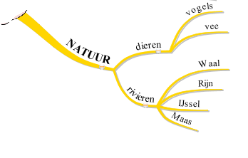
Quantity of mindmap: Number of concepts
BACK
only branches with text count
number is counted
Example 1: 9 concepts
Example 2: 15 concepts

Slide 23
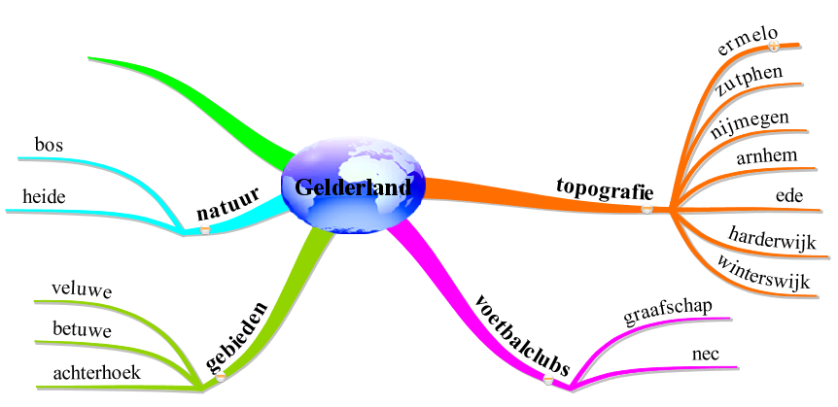
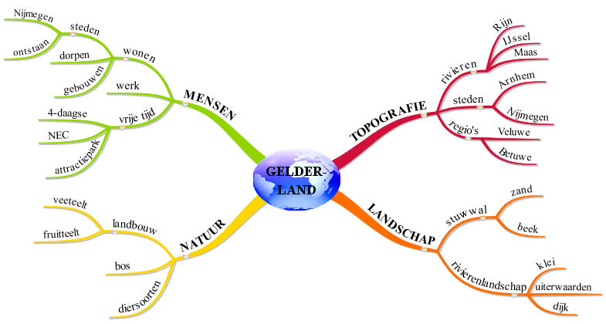
Quality of Concepts (1)
Reproduction of Basis Concepts
BACK
Post Test Pupil 168
Expert Map
Post Test Pupil 156
Expertmap C
less than 25% = score 1

Slide 24
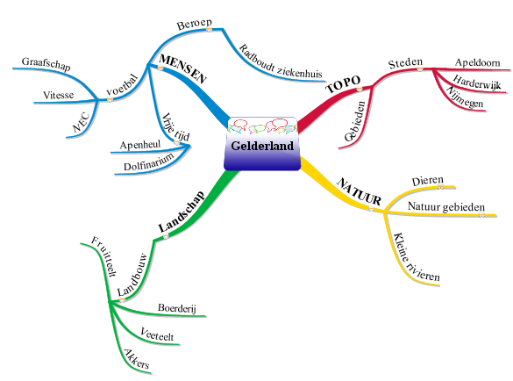
Quality of Concepts (2)
Added Concepts
BACK
Post Test Pupil 192
Expert Map
Expertmap C
10 added concepts = score 3

Slide 25
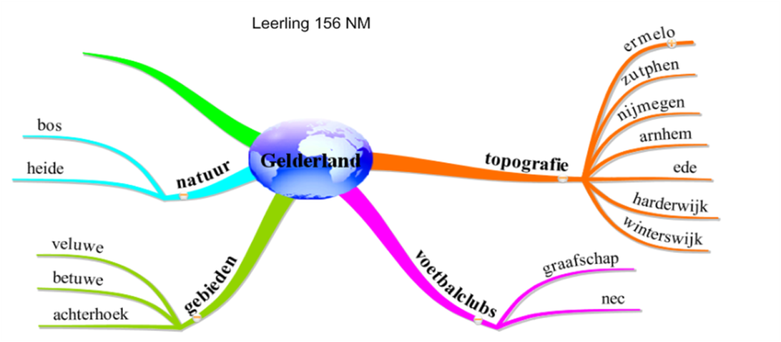
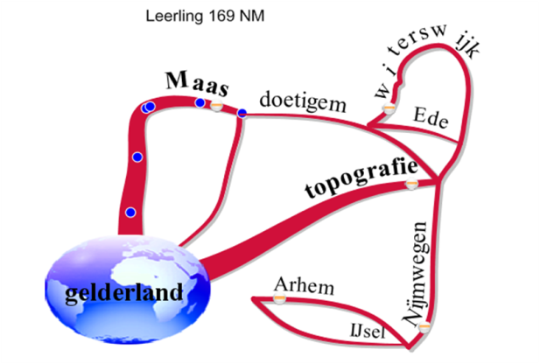
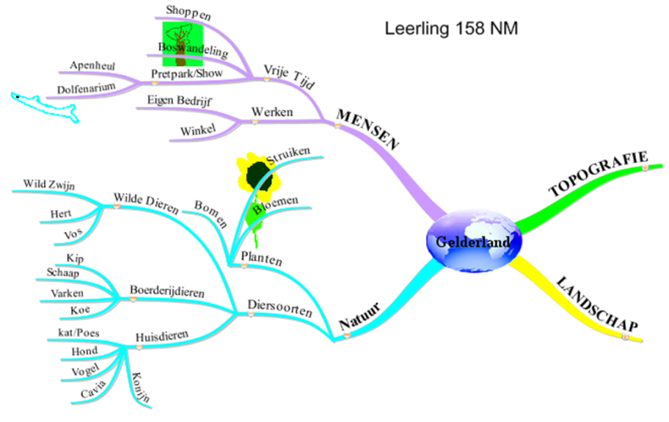
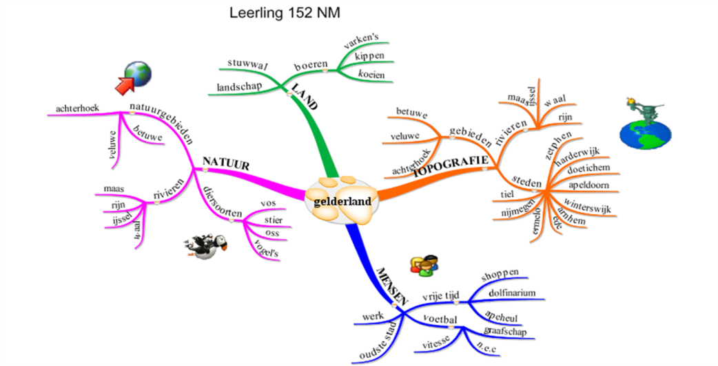
Quality of Concepts (3)
Degree of Hierarchy
BACK
Score:1
Score:2
Score:3
Score:4

Slide 26
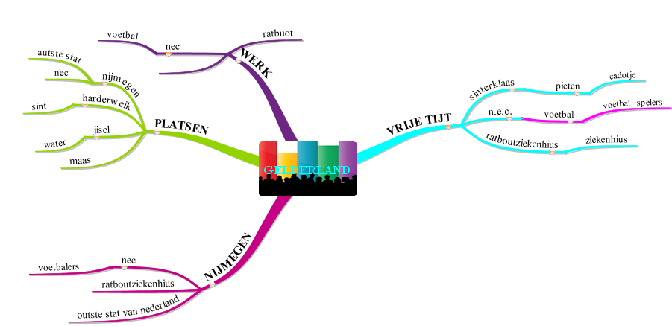
Quality of Concepts (4)
Repetition of Concepts
BACK
Post Test Pupil 192
Our champion of repetition:
7 concepts (or close synonyms) are repeated
at 18 places in the mindmap

Slide 27
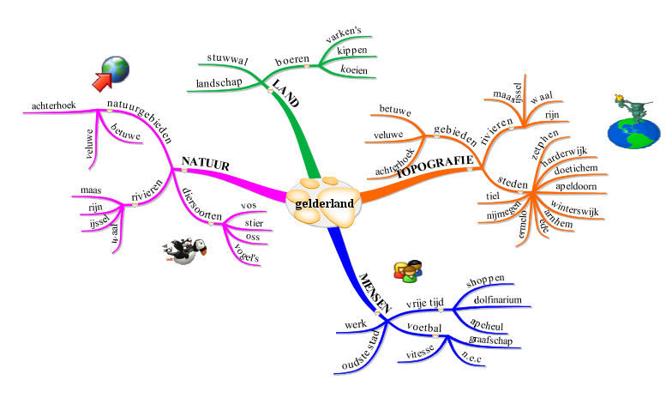
Quality of Images
presence of images
number of images
BACK
relevance of images
Post Test Pupil 152

