Slide 1
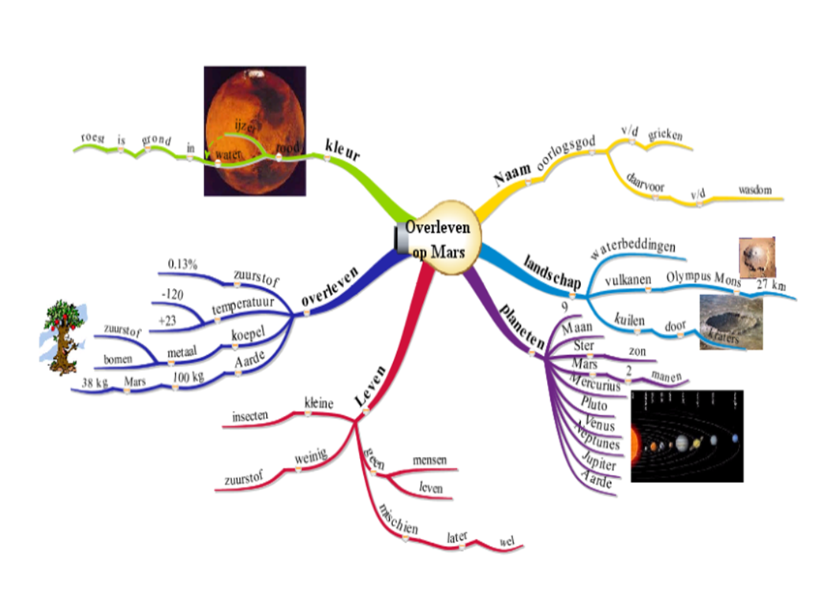
Mind Map Our Way into Effective Student Questioning:
A Principle-based Scenario
Harry Stokhof- HAN University
Bregje de Vries- HAN University
Theo Bastiaens- Open University
Rob Martens- Open University
Figure 1: student mind map grade 5

Slide 2
Introduction
Harry Stokhof
2007- present
1995-2007
Primary School
Teacher’s College
Teacher
Teacher trainer
ICT coördinator
Researcher
2012-2018
PhD trajectory
“How to support teacher guidance
of effective student questioning?”

Slide 3
Content of workshop?
Short theoretical introduction
Hands-on experience: excercise I
Hands-on experience: excercise II
Reflection and connection to scenario
Questions and discussion
Notes:
afbeeldingen verkregen op 13-1-2016 van;
http://www.seven2success.com/nl/2013/11/setting-goals/

Slide 4
What is question-driven learning?
Inquiry-based
learning
Question- driven
learning
Students’
questions
Question-driven Learning
is a specific open form of Inquiry Learning in which students formulate and investigate their own questions, and these questions form the heart of the curriculum
(Chin & Chia, 2004; Scardamalia & Bereiter, 1992; Shodell, 1995; Wells, 2001).

Slide 5
Why question-driven learning?
increases intrinsic motivation for learning (Chin & Osborne, 2008; Deci & Ryan)
connects learning to prior knowledge (Palincsar & Brown, 1984)
stimulates deep and meaningful learning
(Rosenshine, Meister & Chapman, 1996).
fosters development of metacognitive strategies (Chin & Osborne, 2008 ; Scardamalia & Bereiter, 1992)
supports creative thinking
(Keys, 2002; Scardamalia & Bereiter, 1992)
Interest from several domains: Science, Literacy, Numeracy, Arts
(Allmond & Makar, 2010; Gillispie,1990; Osborne & Dillon, 2008).

Slide 6
Challenges for teachers?
How to design and prepare question-driven learning?
select curriculum goals?
anticipate on student questioning?
How to guide diversity in student questioning?
Classroom management?
Optimalise learning outcomes?
Built collective knowledge?
How to monitor and evaluate learning outcomes?
Measure individual progress?
Assess curriculum goals?
Teachers face multiple challenges during implementation
(Chin & Osborne, 2008 Aguiar, Mortimer & Scott, 2009; Nardone & Lee, 2011; Polman, 2004 )

Slide 7
Solutions?
Need for scaffolds which provide: “structured freedom”
The freedom to inquire into a topic of interest in balance
with structure to attain curricular objectives.
Notes:
http://www.google.nl/imgres?hl=nl&biw=1280&bih=645&tbm=isch&tbnid=S_acNdZyJ6InEM:&imgrefurl=http://www.b-lay.com/2013/01/10/finding-your-software-balance/&docid=FiVjzePEj9sY9M&imgurl=http://www.b-lay.com/wp-content/uploads/2013/01/finding_balance_news_625x430.jpg&w=625&h=430&ei=DWiSUta7K4Tcswa634HYDA&zoom=1&ved=1t:3588,r:14,s:0,i:132&iact=rc&page=2&tbnh=176&tbnw=239&start=10&ndsp=21&tx=103.60009765625&ty=108.80000305175781

Slide 8
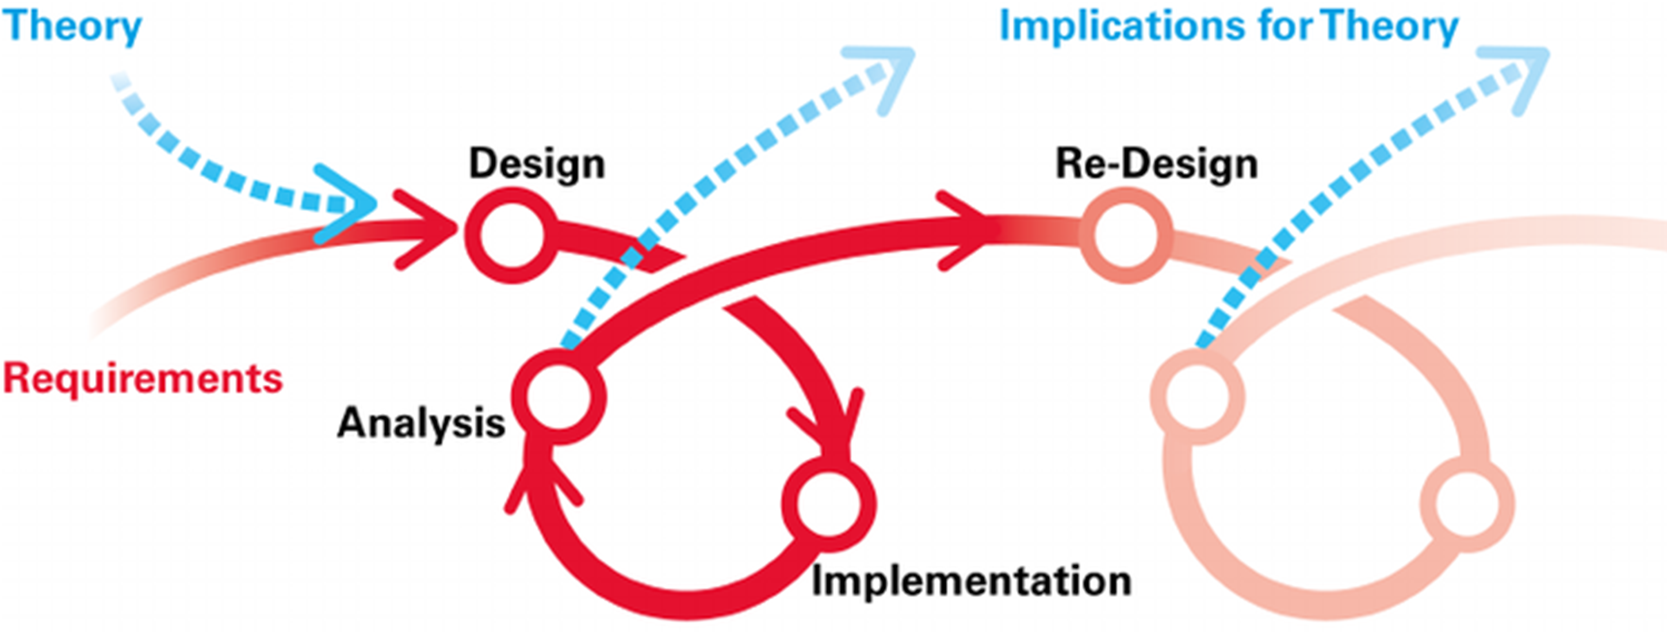
Method?
design-based research
4 years
3 schools
25 teachers
400 pupils
principle-based scenario
based on 4 design principles
flexible
adaptable
Notes:
afbeelding verkregen op 8 mei 2016 van
https://www.nl.capgemini.com/sites/default/files/onlineblog/files/2012/02/Problem-solving.jpg

Slide 9
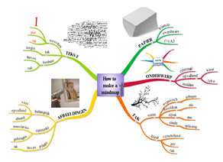
4 Design-principles
acknowledge learning
potential in questioning
provide conceptual
focus for questioning
organize collective responsibility
visualize the
questioning process
Notes:
afbeeldingen verkregen op 30-8-2016 van:
http://www.google.nl/url?sa=i&rct=j&q=&esrc=s&source=images&cd=&cad=rja&uact=8&ved=0ahUKEwjS8fXz2OjOAhVEvRQKHR9hDB0QjRwIBw&url=http%3A%2F%2Fwww.scilogs.fr%2Fl-actu-sur-le-divan%2Fmanuel-valls-pourquoi-jai-voulu-devenir-francais-lassimilation-et-les-neurones-miroirs%2F&bvm=bv.131286987,d.d24&psig=AFQjCNEQYiS79phn61BvuN1qthKxtHECgg&ust=1472631198722327
http://www.google.nl/url?sa=i&rct=j&q=&esrc=s&source=images&cd=&cad=rja&uact=8&ved=0CAcQjRw&url=http://www.kennislink.nl/publicaties/hoe-de-computer-woordbetekenis-leert&ei=c_5ZVJLXNOKv7AaFuoGYCw&bvm=bv.78677474,d.ZGU&psig=AFQjCNFlRHJuU5RkOG6lM5wfsjbPKgEX1A&ust=1415270219028380
http://www.google.nl/url?sa=i&rct=j&q=&esrc=s&source=images&cd=&cad=rja&uact=8&ved=0CAcQjRw&url=http://www.portret-stickers.nl/a-25702598/insecten-en-reptielen/muursticker-spinnenweb-01/&ei=7vtZVLWcMMmf7ganjIHIBw&bvm=bv.78677474,d.ZGU&psig=AFQjCNEpicm2_syhL6VWlX3cFbzoxD30Dg&ust=1415269728515343
mindmaps zijn eigen werk van Harry Stokhof HAN Pabo

Slide 10
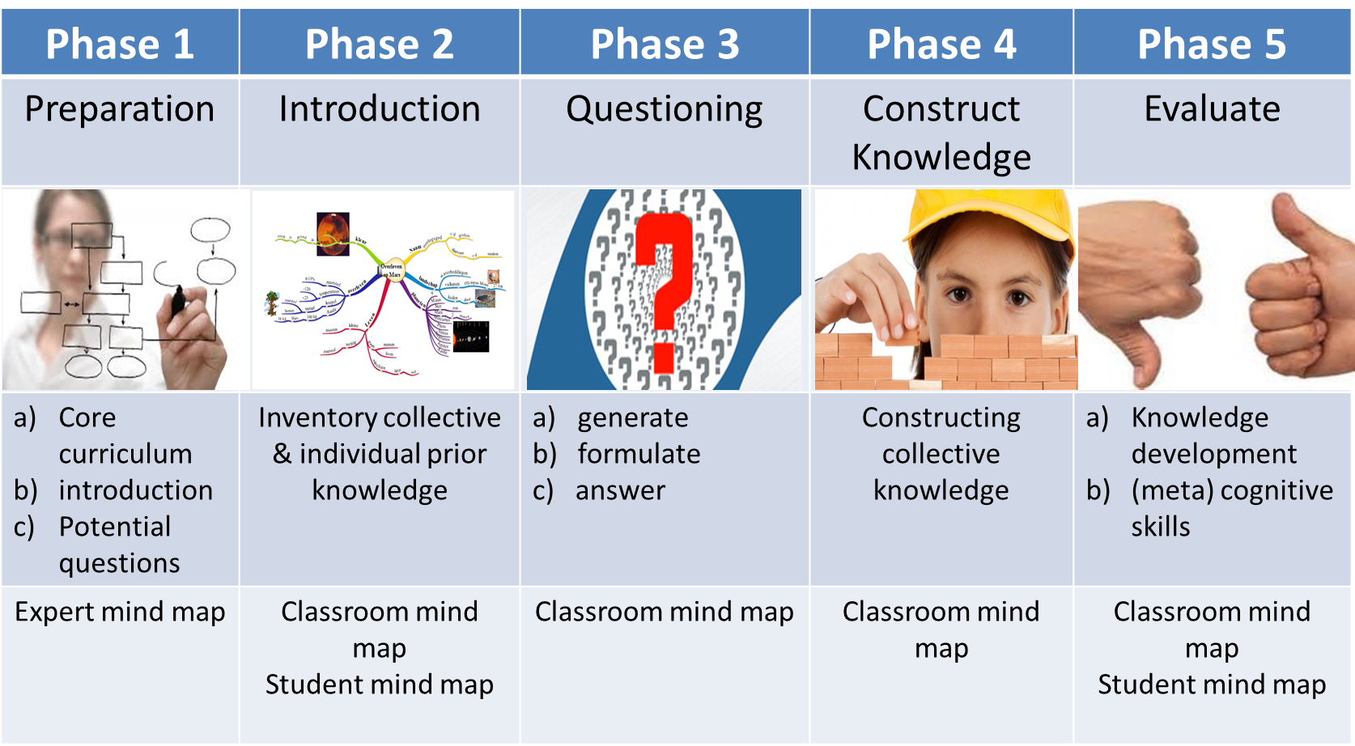
5 Phases in scenario

Slide 11
Why mind mapping as support?
Mind Map is a powerful tool to visualize and structure key concepts ,
easy to learn by students in primary education.
(Buzan & Buzan, 2007; Merchie, 2009)
Digital Mind Mapping: flexible, dynamic, more elaborate functionality.
(Stokhof, et al. 2011; Tergan, 2005)

Slide 12
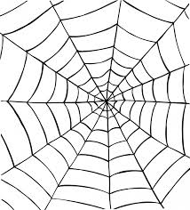
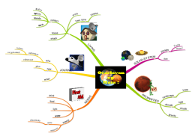
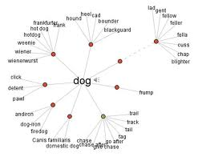
Two functions of mind mapping
Width of curriculum:
offer opportunity to link all interests of students to the topic
Depth of curriculum :
make students aware of meaning and mutual relations of concepts with key concepts
Notes:
Afbeelding verkregen op 9-11-2014 van http://www.effective-contactcenters.com/Network_Based_Contact_Center/Service_Creation_/Icon_Development_Kit.html

Slide 13
Practical Experience

Slide 14
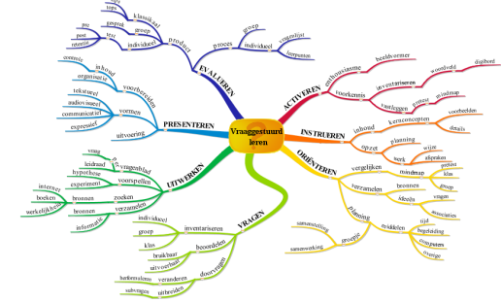
Prepare Expert Mind Map
Selection of key concepts to structure topic

Slide 15
Step 1: activate
“Throw a rock in the pond!”
imagers:
stories
objects
images
video
drama
statements
features:
exciting
motivating
surprising
recognizable
Prompt perplexity and elicit wonderment

Slide 16
Step 2: record associations
Write them down just for your self, first
nice
word 3
word 2
Attention:
1 word on each post-it!
Do not place on the flap, yet.
Notes:
5- min Harry Individueel noteren

Slide 17
Step 3: exchange ideas
introduce your post-its one-by-one
stick on them the flap
explain their relation with chocolate
others can ask questions if needed
take equal turns
Notes:
30 min Harry & Paul voorkennis inventariseren, en structureren

Slide 18
Step 4: cluster ideas
Notes:
met leerlingen eventueel al takken met kernconcepten geven

Slide 19
Step 5: identify names for the clusters
Notes:
met leerlingen eventueel al takken met kernconcepten geven

Slide 20
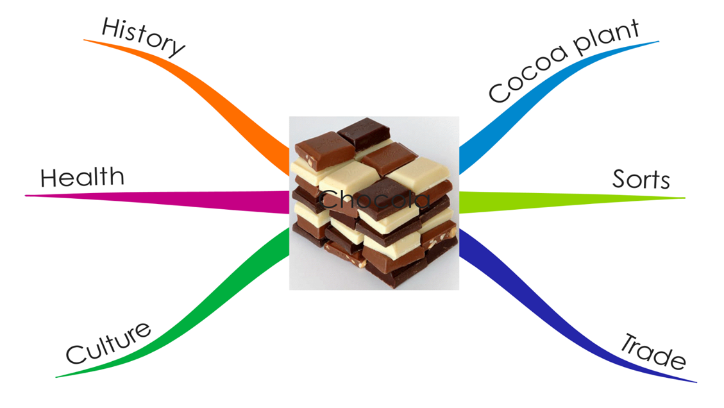
Step 6: comparison to expert mind map?
Notes:
30 min Harry & Paul voorkennis inventariseren, en structureren

Slide 21
Step 7: cluster into mind map branch
Features:
- hierarchical organization
- one word on each branch
- organic shapes

Slide 22
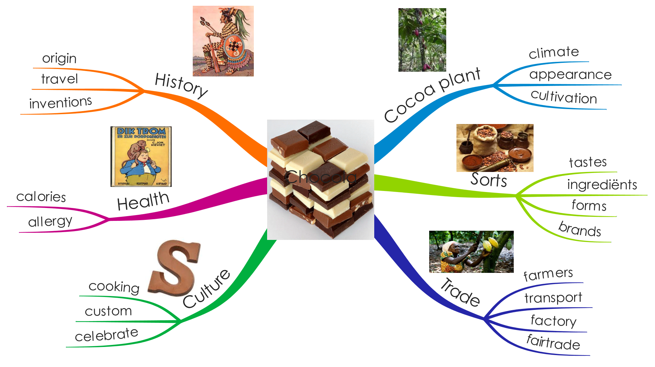
Step 8: merge branches = classroom mind map

Slide 23
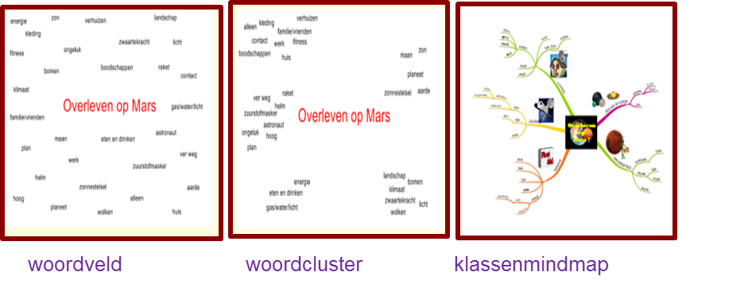
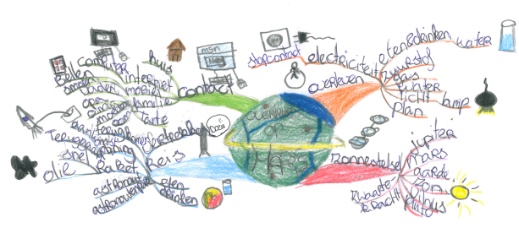
collective prior knowledge
introduction
prior knowledge
exchange
classroom mind map
individuele mindmap
inventory individual prior knowledge

Slide 24
Individual prior knowledge
pre test student mind map

Slide 25
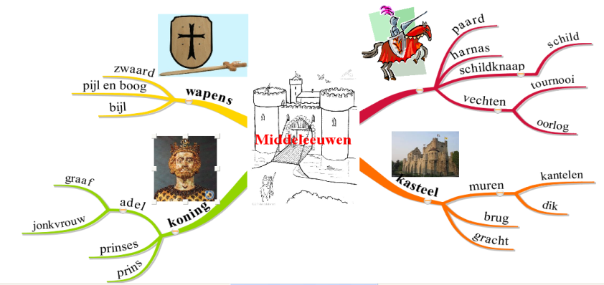
Field of words
Word cluster
Classroom mind map
herendiensten
koning
kerk
koning
kastelen
herendiensten
kastelen
jonkvrouw
stadsrechten
horige
oorlog
klooster
adel
handel
steden
boeren
adel
paarden
horige
bidden
bescherming
ridders
lijfeigenen
pacht
landbouw
zwaard
bescherming
schildknaap
lijfeigenen
schildknaap
boeren
Middle Ages
oorlog
Middle Ages
landbouw
monniken
jonkvrouw
zwaard
stadsrechten
kerk
paarden
godsdienst
handel
nonnen
kruistocht
ambachtslieden
nonnen
ambachtslieden
godsdienst
monniken
kruistocht
pacht
steden
klooster
bidden
introduction of concepts in words and images
Structuring concepts on the basis of similarities and differences
Hierarchical relations between key concepts, details and examples

Slide 26
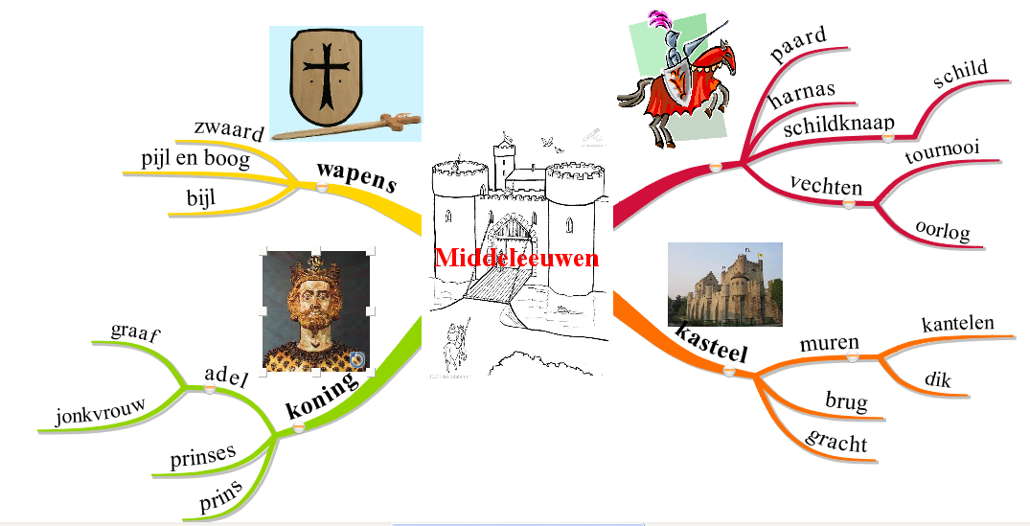
Exploration of Classroom Mind Map
Did you know?
Did you know?
Student explore the concepts in the mind map using various resources
To ensure collective knowledge is understood by all pupils

Slide 27
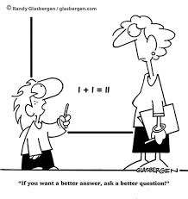
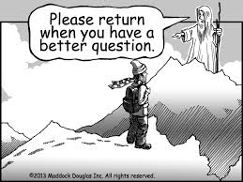
But…What about the students’ questions?

Slide 28
Prompt wonderment?
information gap
become aware not to know (prior knowledge)
want to know (curiosity + identification)
confident to bridge the gap (competence & autonomy)

Slide 29
Practical Experience (II)

Slide 30
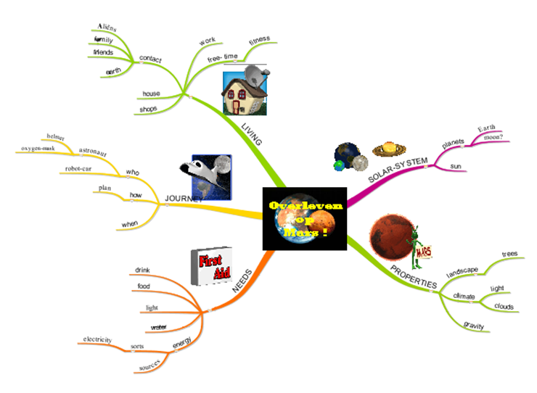
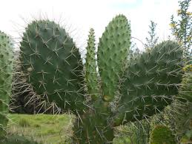
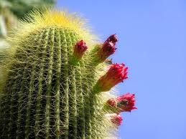
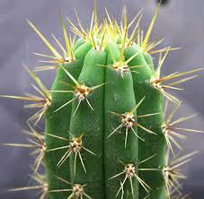
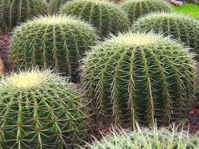
Prepare for student questioning?
?
Which questions you would like to elicit from your students?
?
?
?
?
?
?
?
?
?
?
?
?
?
?
?
?
?
?
?
?
?
?
What prompts might be needed to prompt these questions?
?
?
?
?
?
?
?
?
?
?
?
?
?
?
?
?
?
?
?
?
?
?
?
Which support might be needed to guide students in answering these questions?
Notes:
Ontwerpen inhouden van thema’s met behulp van mindmap. Geven hierin basisdoelen en verrijkingsdoelen aan. Streven naar zone van naaste ontwikkeling voor elk kind. We bieden hier mee breedte van curriculum aan, maar missen nog teveel diepgang in kennisconstructie
Nodig- in expertmindmap een “conceptueel kerncurriculum” vastleggen- waarin de kern van doelen van thema vastligt
Dit gebeurt in veel gevallen ook al, maar de kunst is om hier te kiezen voor “minder maar dieper” als je de juiste kernconcepten of sleutelbegrippen centraal kunt stellen is er minder de druk van “alles moet aan bod komen” want alles is al verbonden met die kernconcepten

Slide 31
Step A: generate questions collectively
Students work in small groups
Students get incentive
Ask non-stop questions
Write down as many as possible
Select 5 most interesting questions
Question brainstorm in small group setting

Slide 32
Step B: relate questions
to mind map
?
?
?
?
?
?
?
?
?
?
?
?
?
?
?
?
?
?
?
?
?
?
?
Inventory of possible interesting questions

Slide 33
Step C: value questions collectively
Why?
How?
Relevance
Feasibility
?
Groups exchange question-selection
Value each others questions
Give suggestions for improvement
What?
Learning Potential
Collective effort to improve question quality

Slide 34
Step D: prioritize questions collectively
?
?
?
?
?
?
?
?
?
?
?
?
?
?
?
?
?
?
?
?
?
?
?
?
?
?
?
?
?
Most interesting questions are selected en connected to the Classroom Mind Map
.

Slide 35
Step E: adopt questions
?
?
?
?
?
?
?
?
?
?
Students choose a question to inquire

Slide 36
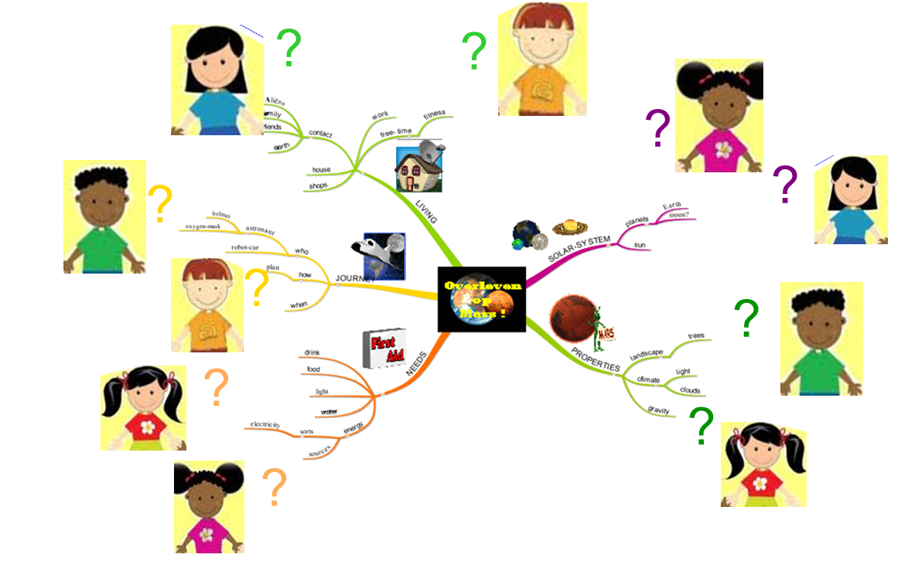
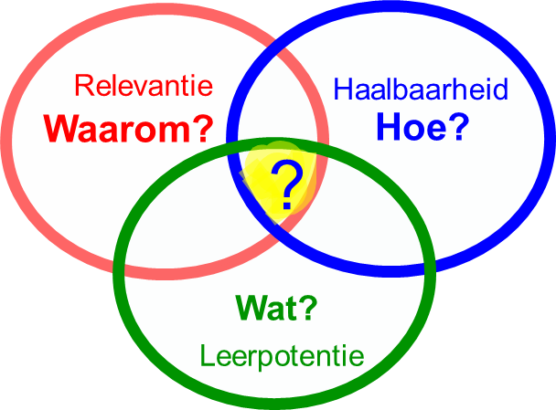
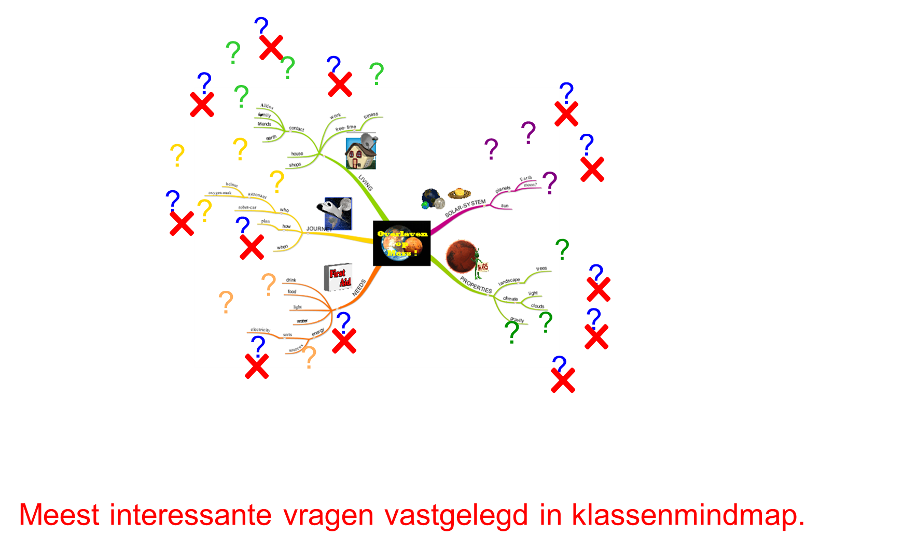
Summary:
In 5 steps to effective questions
A: brainstorm
B: relate questions
?
?
?
?
?
?
?
?
?
?
?
?
?
?
?
?
?
?
?
?
?
?
?
E: adopt questions
C: value questions
D: priortize questions

Slide 37
Constructing knowledge?

Slide 38
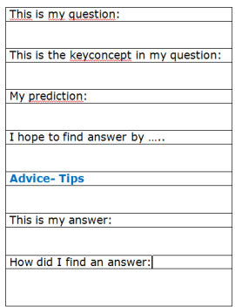
Step I: preparing for inquiry
?
?
?
?
?
?
?
?
?
?
?
Students prepare for inquiry using work-sheet

Slide 39
Step II: conducting inquiries
Student investigate their chosen questions

Slide 40
Step III: answering inquiries
?
?
?
?
?
?
?
?
?
?
?
Answers on questions are processed and linked to the Classroom Mind Map.

Slide 41
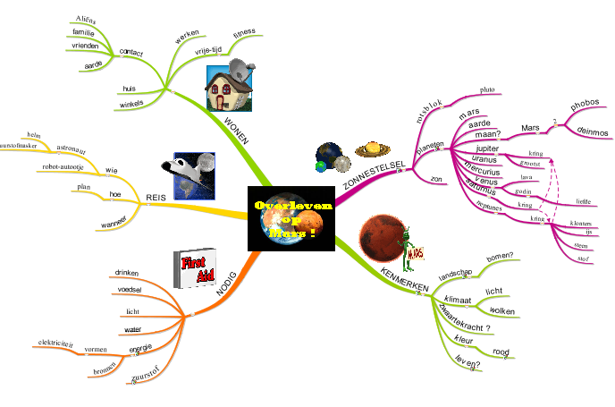
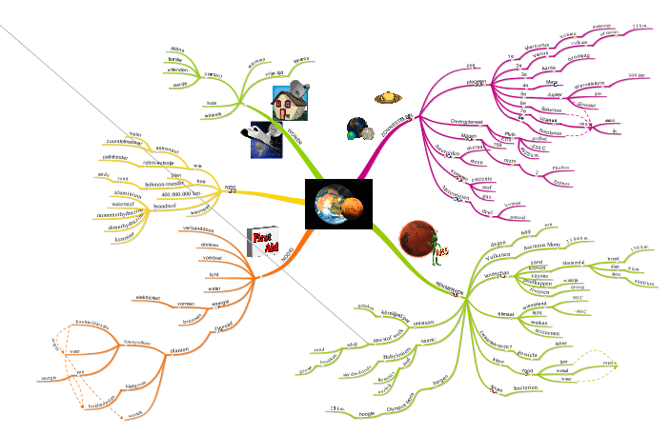
Step IV: visualizing collective knowledge development
Classroom Mind Map week 1
Classroom Mind Map week 2
Classroom Mind Map week 6
Development of collective knowledge made visible by
extending and reconstructing Classroom Mind Map

Slide 42
How to monitor and evaluate?

Slide 43
Objectives of evaluation
make students aware of development in
knowledge
attitude
skills
tools for self- & peer assessment, such as
mindmaps
observation rubrics
blobtree

Slide 44
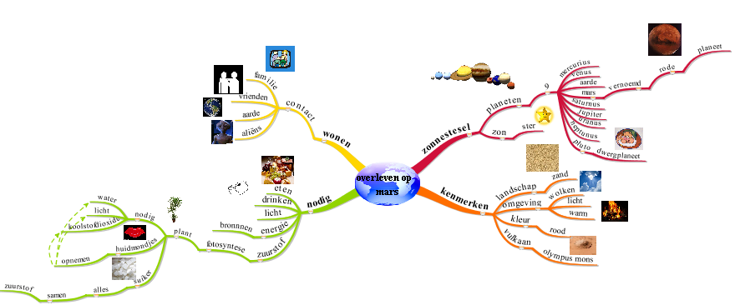
Evaluation of individual knowledge
compare pretest to posttest mind map
pretest
posttest
Reflection on own cognitive development

Slide 45
Evaluation of collective knowledge
Development of classroom mind map
Initial classroom mind map
Final classroom mind map
Reflect on collective cognitive development

Slide 46
Evaluation of meta cognition(1)
Contribution of student questions?
?
?
?
?
?
?
?
?
?
?
student questions
Final classroom mind map
Reflect on metacognitive development

Slide 47
Evaluation of meta cognition(2)
This is my question:
This keyconcept is addressed:
My prediction:
I hope to find answer by …..
Advice- Tips
This is my answer:
How did I find an answer:
This is my follow-up question:
setting objectives? (meta-cognitive skill)
relating question to core curriculum? (cognitive skill)
seeking direction (information-seeking skill)
selecting sources (information-seeking skills)
attaining objectives? (meta-cognitive skill)
reflection on suitability of sources (information-seeking skill)
inquisitive stance

Slide 48
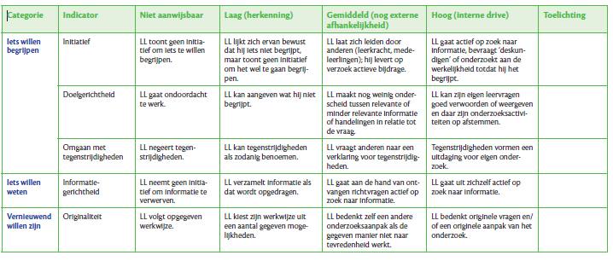
Evaluation of inquisitive stance
Rubric for (self)observation

Slide 49
Blobtree
Example self & peer evaluation (1)

Slide 50
Example self & peer evaluation (2)

Slide 51
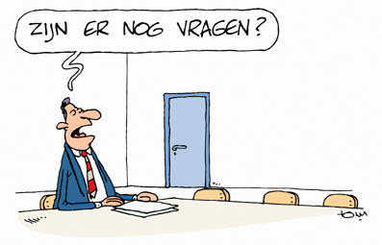
Are there any questions??
Email:
harry.stokhof@han.nl
Researchgate: https://www.researchgate.net/profile/Harry_Stokhof/publications
Notes:
afbeelding verkregen op 29-3-2017 van:
http://www.vrijspreker.nl/wp/2008/10/staatsbank-karl-marx-is-wederopgestaan/

