Slide 1
Teacher support for guiding effective student questioning
A principle based-scenario for question-driven education
Dr. Harry Stokhof
ATEE april 2019

Slide 2
dr. Harry Stokhof HAN University of Applied Sciences, Nijmegen, The Netherlands, Europe.
1995-
2007
2012-
2017
Primary School Teacher
PhD research project
2007-
present
2019-
2021
Teacher Educator
Researcher
Educational Designer
How to support teachers in guiding effective student questioning?
Post-doc research project

Slide 3
What is question-driven learning?
Question- driven
learning
Students’
questions
Inquiry-based
learning
Question-driven Learning (QDL)
is a specific open form of Inquiry Learning in which students formulate and investigate their own questions, and these questions form the heart of the curriculum
(Chin & Chia, 2004; Scardamalia & Bereiter, 1992; Shodell, 1995; Wells, 2001).

Slide 4
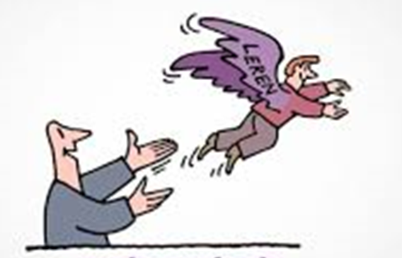
Why is student questioning important?
Increases intrinsic motivation for learning (Chin & Osborne, 2008; Deci & Ryan)
Connects learning to prior knowledge (Palincsar & Brown, 1984)
Supports deep and meaningful learning (Rosenshine, Meister & Chapman, 1996).
Develops metacognitive strategies (Chin & Osborne, 2008 ; Scardamalia & Bereiter, 1992)
Elicits creative thinking (Keys, 2002; Scardamalia & Bereiter, 1992)
Relevant for Science, Literacy, Numeracy, Arts (Allmond & Makar, 2010; Gillispie,1990; Osborne & Dillon, 2008).
LEARNING

Slide 5
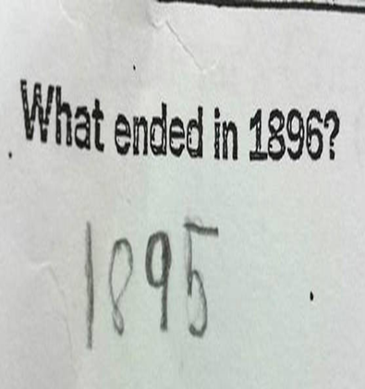
Present state of student questioning
Teachers ask 95% of all questions in class.
Teacher questioning stifles student questioning.
Students give answers, but seldom ask questions.
A lot of student question potential remains unused.

Slide 6
Teachers as change agents
Teachers have powerful potential
to support change
(Fullan, 2012)
Lasting change in science education
depends on teachers
(Yoshioka, Matsumoto, & Fulton, 2017)

Slide 7
Teachers seek the balance
opportunity
for student
questioning?
attaining
learning
outcomes?
How to guide effective student questioning?

Slide 8
Teachers’ challenges
DESIGN?
Select curriculum goals?
Anticipate on student questioning?
GUIDE?
Classroom management?
Optimalise learning outcomes?
Build collective knowledge?
EVALUATE?
Measure individual progress?
Assess curriculum goals?

Slide 9
Development of solution in four studies
RESEARCH QUESTION | TYPE OF STUDY
What is already known? | Literature review
Solution for teachers? | Development study
Effect on students? | Effect study
Transfer to other schools? | Implementation study

Slide 10
Study 1: literature review
RESEARCH QUESTION
What is known in the literature about teacher guidance of effective student questioning?

Slide 11
Study 1: research methology
Relevant studies
Search query (> 450)
First selection (200)
Selected for analysis (36)

Slide 12
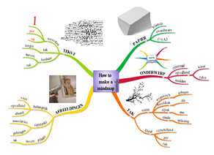
Four principles for teacher guidance
Study 1: results
1
2
3
4
acknowledge learning
potential in questions
provide conceptual
focus for questioning
organize collective responsibility
visualize the
questioning process

Slide 13
Study 2: development study
RESEARCH QUESTION
How to support teachers to design, guide and evaluate their guidance of effective student questioning?

Slide 14
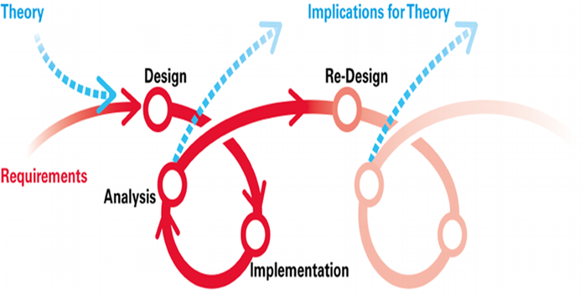
Study 2: design-based research methology
Five years: 2012-2017
Develop solution
Prototyping
5 iterative cycles
Participatory design
12 teachers
2 primary schools

Slide 15
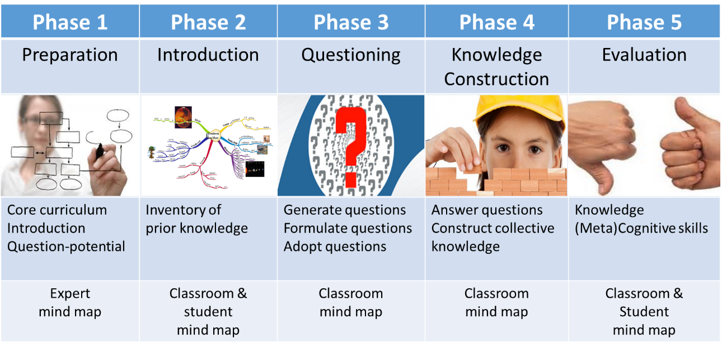
Five Phase Scenario for support
Study 2: developed solution

Slide 16
Study 2: Results for teacher guidance
Scenario was perceived by teachers as:
Relevant
Practical
Effective

Slide 17
Study 3: effectiveness study
RESEARCH QUESTION
How effective is the scenario for guiding students to learn the curriculum?

Slide 18
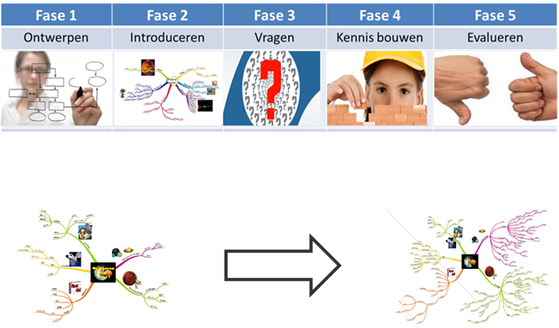
Study 3: research methology
Trial of the scenario
Six weeks
12 classes
270 students
Pre and posttests
Mindmaps
Knowledge tests

Slide 19
Study 3: results for students
SHORT TERM EFFECTS
Learn core curriculum
Extend knowledge
Refine knowledge structures
LONG TERM EFFECTS
Highly motivated to learn
Develop metacognitive skills
Prepared for life-long learnig

Slide 20
Study 4: implementation study
RESEARCH QUESTION
What is the robustness of a principle-based scenario for guiding effective student questioning?

Slide 21
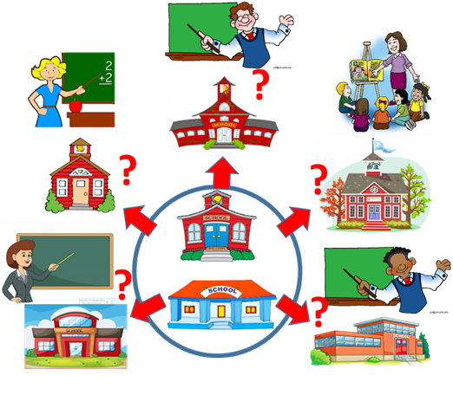
Study 4: research methology
Scenario- trialed by
20 trainers
25 schools
103 teachers
Questionnaire
How was scenario used?
How was scenario experienced?
Which intentions for future use?

Slide 22
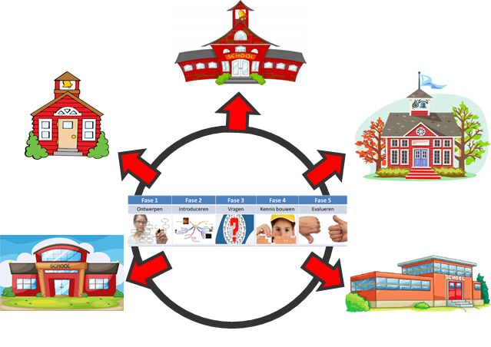
Study 4: results for other teachers
Scenario = robust in multiple contexts
80% van leraren
positive or very positive
want to continue use
Independent of
School characteristics
Teacher characteristics

Slide 23
CONCLUSION
Scenario
Supports teachers in guiding effective student questioning
Supports students in attaining curriculum goals and more..
Is relevant and effective in multiple educational contexts

Slide 24
Transfer to other educational contexts
Teacher Education
As content
As teaching strategy for teacher educators
Higher and Vocational Training
To bridge gap between practice and theory
School teams
To support teacher participation in school development

Slide 25
Recommendations for teachers
Develop a shared vision
Discuss: What should be the benefits of QDL for our students?
Discuss: What does QDL require from us as teachers?
Organize collective support
Prepare collectively
Evaluate collectively
Practice to become role model
Develop your own inquisitive stance
Explore the possibilities to use parts of scenario
See the scenario as modulair and flexible
The principes are guidelines: feel free to adapt scenario to local needs and concerns
Experiment with application of 4 principles

Slide 26
Wanting to know more?
harry.stokhof@han.nl
www.researchgate.net
Linked-In: Harry Stokhof

