Slide 1
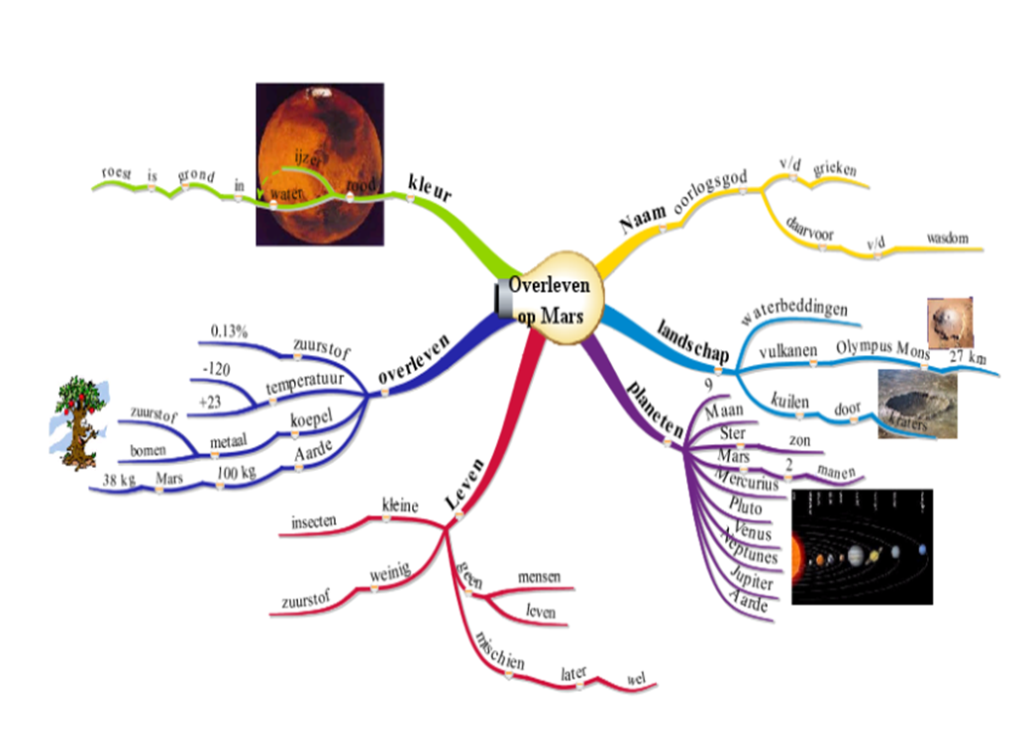
Question-driven Mind Mapping
Supporting Teachers and Students by Digital Mind Mapping to Attain the Curriculum in Question-Driven Learning.
Harry Stokhof- HAN University
Bregje de Vries- HAN University
Theo Bastiaens- Open University
Rob Martens- Open University
Figure 1: student mind map grade 5

Slide 2
Theoretical framework
Importance of Question- driven Learning
Growing interest in role of students’ questions in Science, Literacy and Mathematics Education.
(Allmond & Makar, 2010; Gillispie,1990; Osborne & Dillon, 2008).
Empirical evidence for educational potential of students’ questions:
increases intrinsic motivation for learning (Chin & Osborne, 2008; Deci & Ryan)
connects learning to prior knowledge (Palincsar & Brown, 1984)
stimulates deep and meaningful learning
(Rosenshine, Meister & Chapman, 1996).
fosters development of metacognitive strategies (Chin & Osborne, 2008 ; Scardamalia & Bereiter, 1992)
Question-driven Learning is a specific open form of Inquiry Learning
in which students formulate and investigate their own questions
(cf. Chin & Chia, 2004; Scardamalia & Bereiter, 1992; Shodell, 1995; Wells, 2001).

Slide 3
Theoretical framework
Teachers and Question-driven Learning
Teachers are positive about forms of Inquiry learning.
(Sikko, Lyngved & Pepin, 2012)
Implementation in schools meets challenges, despite benefits for teachers and students.
(Chin & Osborne, 2008)
Teachers seek balance between providing freedom for question articulation and responsibility to attain the curriculum.
(Brown, 1992; Rop, 2003; Wells, 2001)
Teachers need support in designing, coaching and evaluating Question-driven Learning
(Aguiar, Mortimer & Scott, 2009; Nardone & Lee, 2011; Polman, 2004 )

Slide 4
Theoretical framework
Literature on Guidance of Question behavior
Three subsequent phases in questioning behavior
1) Generating questions
2) Formulating questions
3) Inquiring and answering questions
(cf. Greasser & Wisher, 2001; Van der Meij, 1994)
Three recommendations for guidance
1) Teachers need to support students by valuing and discussing questions before start of inquiry
2) Collectively generating and formulating questions is more effective for guidance of question behavior
3) Question behavior might be enhanced by creating collaborative platform which visualizes development.
(Stokhof, De Vries, Bastiaens & Martens, under review)

Slide 5
Question-driven Mind Mapping
Digital Mind Mapping as support
Digital mind maps might support the balance between guiding question behavior and attainment of the curriculum in QDL
Figure 2: student mind map grade 5
Mind Map is a powerful tool to visualize and structure key concepts ,
and easy to learn for students in primary education.
(Buzan & Buzan, 2007; Merchie, 2009)
Digital Mind Mapping: flexible, dynamic, more elaborate functionality.
(Stokhof, et al. 2011; Tergan, 2005)

Slide 6
Scenario
Testing hypotheses by implementing scenario
Scenario for Question-driven Mind Mapping
(Stokhof & De Vries, 2009; Stokhof, Sluijsmans, Vlokhoven & Peters, 2011)
Design-based research
Scenario was developed and tested in collaboration with practitioners in primary education
Multiple cycles of (re)design, implementation and evaluation
Principle-based scenario
Allowing flexibility and adaptability for multiple contexts
Allowing ownership for teachers in making personal choices during implementation
(Zhang, Scardamalia, Reeve, & Messina, 2009)

Slide 7
DYNAMIND
Scenario
Design principle
The central design principle of the scenario is: “structured freedom”
The freedom to inquire into a topic of interest is balanced
by the visible structure of the core curriculum in the Mind Map,
to scaffold both individual and collective cognitive development.
Notes:
http://www.google.nl/imgres?hl=nl&biw=1280&bih=645&tbm=isch&tbnid=S_acNdZyJ6InEM:&imgrefurl=http://www.b-lay.com/2013/01/10/finding-your-software-balance/&docid=FiVjzePEj9sY9M&imgurl=http://www.b-lay.com/wp-content/uploads/2013/01/finding_balance_news_625x430.jpg&w=625&h=430&ei=DWiSUta7K4Tcswa634HYDA&zoom=1&ved=1t:3588,r:14,s:0,i:132&iact=rc&page=2&tbnh=176&tbnw=239&start=10&ndsp=21&tx=103.60009765625&ty=108.80000305175781

Slide 8
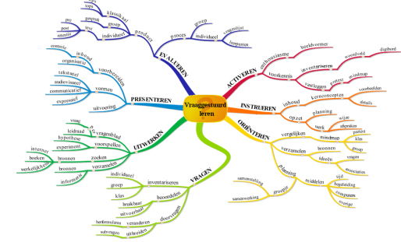
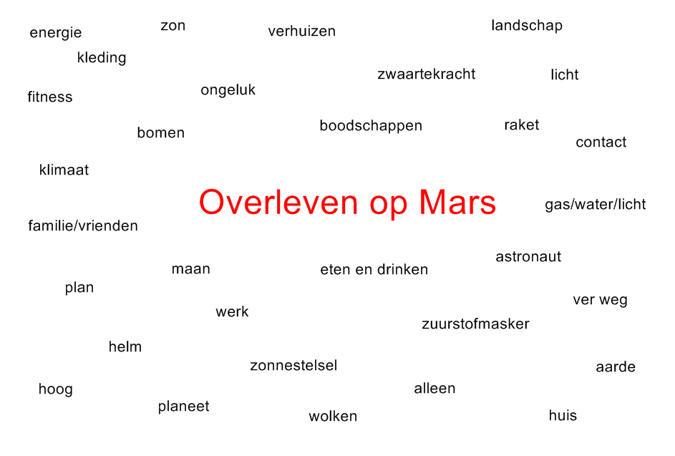
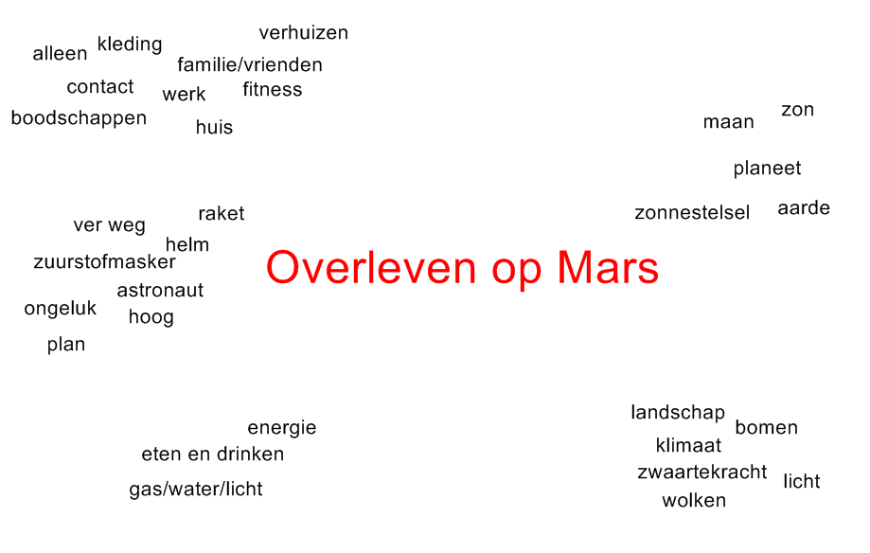
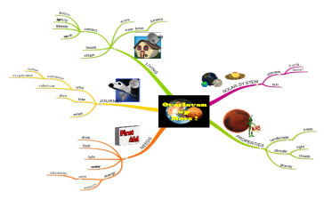
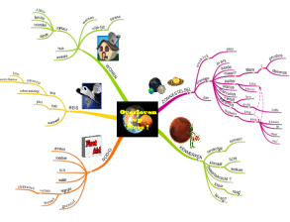
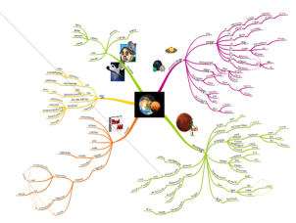
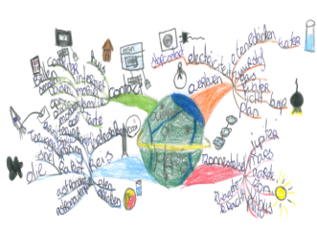
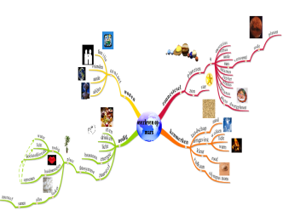
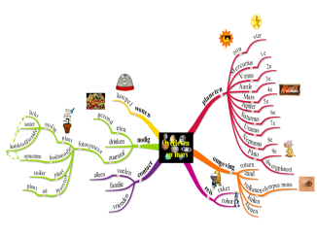
Scenario
4 phases of digital mind mapping
design of core curriculum
activate & structure prior knowledge
word field
word cluster
classroom mind map
Core
Elaboration
Figure 3: teachers mind map
Figure 4: development classroom mind map
Design Expert Mind Map as visualization of conceptual core curriculum
(cf. Bereiter, 2004; Applebee, 1996)
Make inventory and structure prior knowledge by constructing a Classroom Mind Map
(Stokhof, et al., 2012)
generate & guide questions
monitor & evaluate learning outcomes
classroom mind map 1
classroom mind map 2
classroom mind map 10
pre test
post test
retention test
Figure 5: elaboration of classroom mind map
Figure 6: mind map as assessment instrument
Connect questions to the classroom mind map.
Aim: coaching and exchanging questions and learning outcomes in a community of learners
(cf. Scardamalia, 2002)
Evaluation of individual en collective cognitive development by mind map test & monitoring the development of the classroom mind map. (cf. Brinkman, 2003)

Slide 9
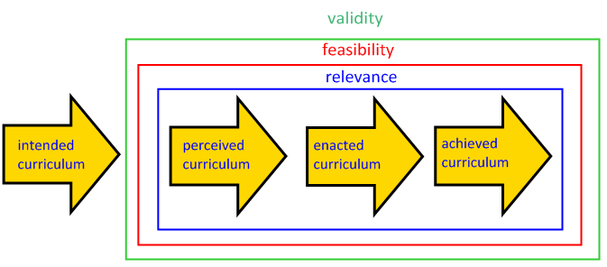
Scenario
Variables to determine quality of scenario
Relevance: how is the scenario perceived by teachers as contributing to solving problems in guidance of QDL?
Feasibility: how feasible is the scenario when teachers use it in their daily practice guiding QDL?
Validity: what is the contribution of the scenario in supporting teachers
to guide QDL?
Figure 7: variables in curriculum innovation trajectory (cf. Van de Akker, 2003, Van Nieveen, 2009)

Slide 10
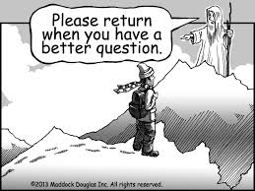
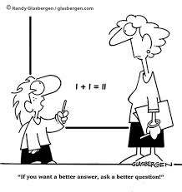
Research Question
What is the relevance, feasibility and validity of a principle-based scenario using digital mind mapping to scaffold the guidance of effective question behavior?

Slide 11
DYNAMIND
Method (2)
Population:
2(sub)urban primary schools in the Netherlands
8 classrooms (cases)
grades 4-6 (9-12 year olds)
12 teachers
250 students
Schools selected:
Teach (social) science subjects project-based in periods of 6-8 weeks
Were willing to experiment with question-driven teaching and learning
Took initiative to participate in this research
Notes:
(voorbeeld meenemen)

Slide 12
DYNAMIND
Method (3)
data collection
 | design of core curriculum | activate & structure prior knowledge | generate & guide questions | monitor & evaluate learning outcomes
Relevance | Audio recordings Field notes Interviews | Observations Video recordings Field notes CMM Interviews | Observations Video recordings Field notes CMM Student work Interviews | Observations Video recordings Field notes CMM Student work Pre- Posttest MM Interviews
Feasibility | Audio recordings Field notes EMM Interviews | Observations Video recordings Field notes CMM Interviews | Observations Video recordings Field notes CMM Student work Interviews | Observations Video recordings Field notes Interviews
Validity | Audio recordings Field notes EMM Interviews | Observations Video recordings Field notes EMM & CMM Interviews | Observations Video recordings Field notes CMM Student work Interviews | Observations Video recordings Field notes EMM, CMM Student work Pre- Posttest MM Interviews

Slide 13
Results phase 1
design of core curriculum in EMM
Variables | Results Prototype I | Adaptations in redesign | Results Prototype II | Suggestions for future design
Relevance | “Difficult but necessary to get overview on topic” “Offers opportunity to work conceptually instead of activity based” | No significant changes | “Precondition for working with the scenario” “Offers strong support when constructing CMM” | Need to make core curriculum more explicit within EMM
Feasibility | “Doable with guided practice” |  | “Doable with peer collaboration”
Validity | Supportive to get overview on topic Sometimes difficult to acknowledge other possible structuring |  | Necessary for identifying key concepts and their mutual relations Expert mind map tends to get rather large

Slide 14
Results phase 2
structuring prior knowledge in CMM
Variables | Results Prototype I | Adaptations in redesign | Results Prototype II | Suggestions for future design
Relevance | Logical step to involve prior knowledge High level of student commitment | Emphasizing principle-based character of scenario Scaffolding opportunities for “speeding up the pace” Showing possibilities for small group work Exchanging examples of “short cuts” and other good practices | Continuous high level of student commitment | More specific attention for Big Ideas when activating prior knowledge
Feasibility | Time consuming (taking up to 4 weeks!) Concerns about some childrens’ participation levels when having whole class sessions |  | Most classes able to construct CMM in 2 weeks or less More children actively involved during construction
Validity | Classroom mind map was representative of prior knowledge |  | Teachers are aware CMM could have collected more specific prior knowledge

Slide 15
Results phase 3
generating and formulating questions in CMM
Variables | Results Prototype I | Adaptations in redesign | Results Prototype II | Suggestions for future design
Relevance | Strong need for more support in guiding question behaviour | Collectively generating, valuing, developing, selecting and adopting questions [Question Formulation Technique] | Growing confidence in ability to guide question behaviour | Exchanging good practice Question Formulation Technique Stimulating progressive inquiry
Feasibility | Quite difficult for students to generate questions Time consuming to help students to develop raw questions Criteria for question quality in relation to CMM were useful |  | Teachers report collective effort significantly improved effectiveness of guidance Students improved significantly in generating and formulating questions Many students adopted each other’s questions
Validity | Quality of raw questions low Lack of time for guidance hampers learning outcomes |  | Quality of questions improved because of more effective guidance Yet still limited progressive inquiry

Slide 16
Results phase 4
Extending CMM and monitoring development
Variable | Results Prototype I | Adaptations in redesign | Results Prototype II | Suggestions for future design
Relevance | Teachers in need of tool to monitor development | No significant changes except for suggestions to optimize planning and more intense use of CMM | MM and CMM regarded as process tools To determine attainment of knowledge goals probably additional information needed | more explicit attention for key concepts in constructing CMM (need for more explicit core curriculum in EMM) Exchanging good practices use CMM Experiment with variations on MM test - memory test making wordlist - structuring test (on given wordlist) -diagnostic interview
Feasibility | CMM not fully used because of stagnation in phase 2 and 3 In all classes pre- posttest administered |  | Most teachers were able to use CMM to visualize development In some CMM’s additional material from other lesson activities was added
Validity | For most teachers development discernable in pre-posttest Some notable deviations from expectations |  | Most teachers found significant improvement in CMM Development in pre-posttest was mixed- ranging from 40-100% of core curriculum

Slide 17
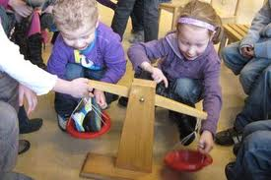
Conclusion
Question behavior is enhanced by using Mind Maps as collaborative platform for visualizing knowledge construction
Mind Mapping supports teachers in establishing structured freedom
(balance between freedom for question articulation and responsibility to attain the curriculum).
Additional research is needed to establish
the functionality of Mind Mapping for monitoring individual development
most effective ways of identifying core curriculum
how to combine elaboration of MM with optimal overview on topic
Notes:
http://www.google.nl/url?sa=i&rct=j&q=&esrc=s&frm=1&source=images&cd=&cad=rja&docid=oAN0tJfG56Gl0M&tbnid=Ev1bn5_Y5Wcy3M:&ved=0CAUQjRw&url=http%3A%2F%2Fwww.toevalgezocht.nl%2Fprojecten%2Fcultura_familia_i_project_van_een_jaar%2Fbeeldverslag%2F7845&ei=2WeSUorAKeiw0QWO3IDYDg&bvm=bv.57127890,d.Yms&psig=AFQjCNGSzqLneteEmsFEzAzh78lcNFm8jQ&ust=1385412943135713

Slide 18
Discussion
What is an object measure for assessing question behavior?
Could other visual organisers be used for establishing structured freedom?
Notes:
http://www.google.nl/url?sa=i&rct=j&q=&esrc=s&frm=1&source=images&cd=&cad=rja&docid=oAN0tJfG56Gl0M&tbnid=Ev1bn5_Y5Wcy3M:&ved=0CAUQjRw&url=http%3A%2F%2Fwww.toevalgezocht.nl%2Fprojecten%2Fcultura_familia_i_project_van_een_jaar%2Fbeeldverslag%2F7845&ei=2WeSUorAKeiw0QWO3IDYDg&bvm=bv.57127890,d.Yms&psig=AFQjCNGSzqLneteEmsFEzAzh78lcNFm8jQ&ust=1385412943135713

