Slide 1
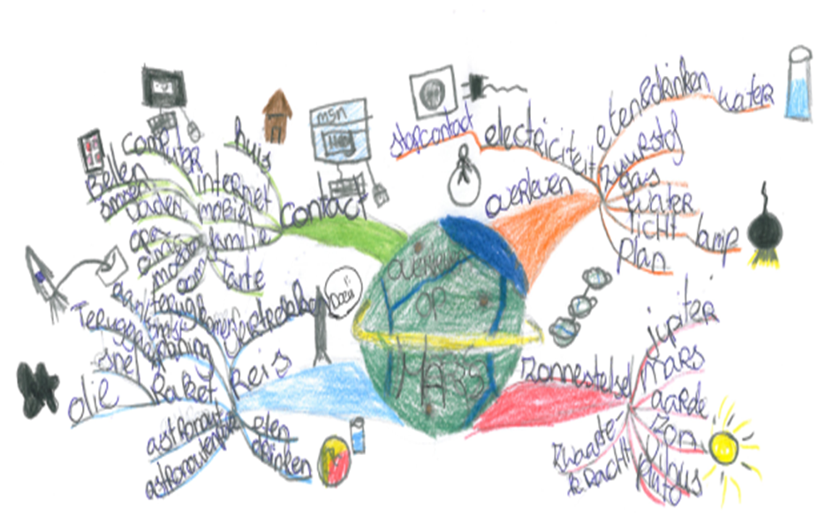
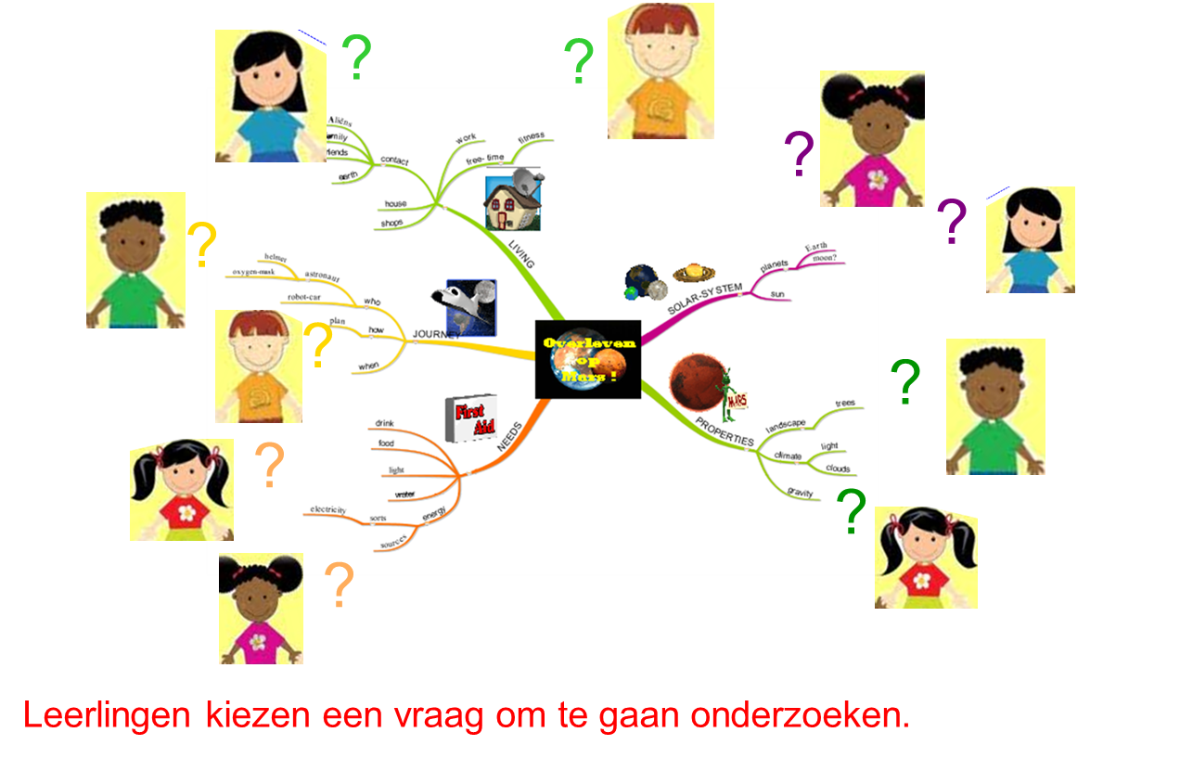
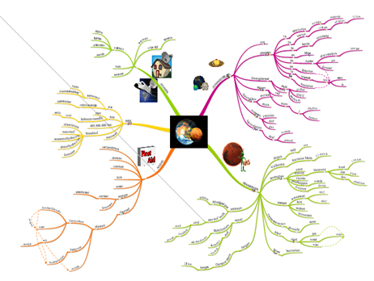
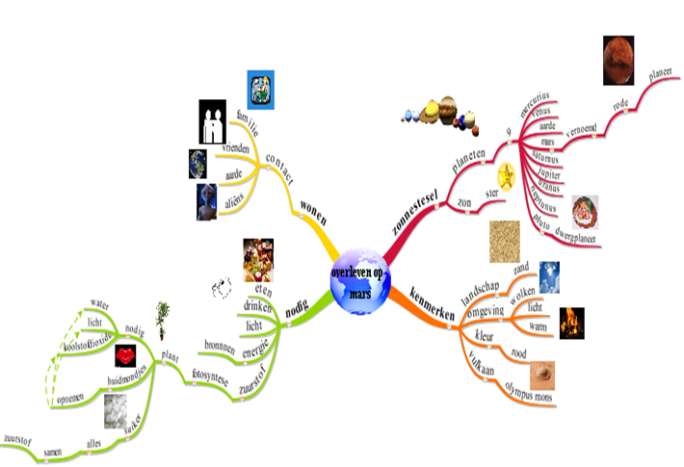
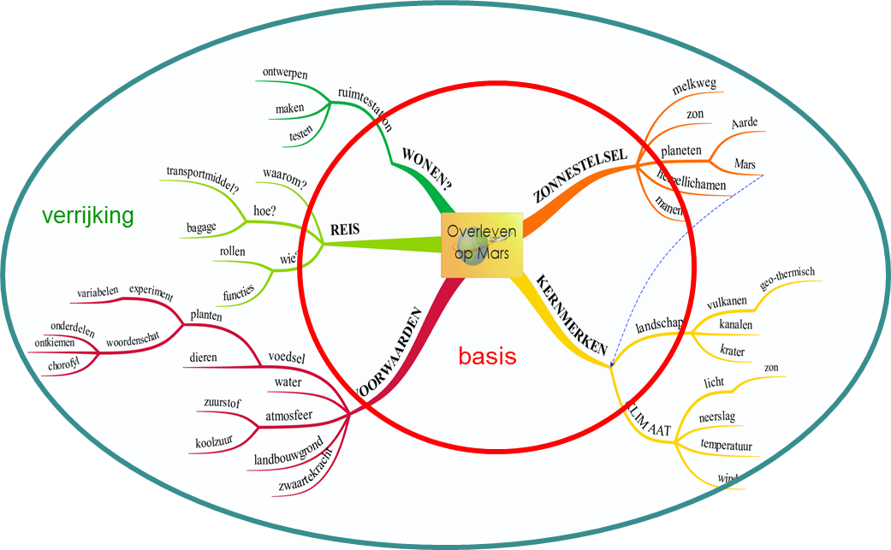
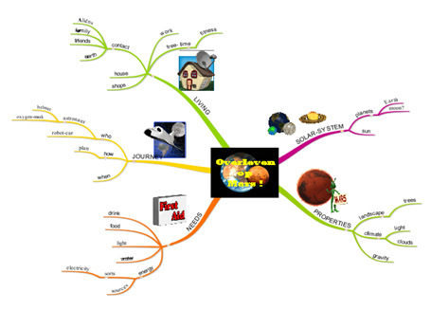
SCENARIO FOR GUIDING EFFECTIVE STUDENT QUESTIONING
CONTEXT & RATIONALE
Why student questioning?
Challenges for teachers?
Design principles?
elicits intrinsic motivation
supports inquisitive stance &
“deep learning” of domain content
develops metacognitive skills
guide effective questioning:
align student questioning to curricular goals
conceptual focus
seek potential for learning
collective responsibility
visualize questioning process
DESIGN-BASED RESEARCH: MIND MAP-SUPPORTED SCENARIO
teacher
mind map
pretest
mind map
initial classroom
mind map
aligning
questions
expanded classroom
mind map
posttest
mind map
RESEARCH QUESTION
What is relevance, practicality and effectiveness of a mind map supported scenario for guiding effective student questioning in primary education?
METHOD: RESEARCH-BASED DESIGN
Participants
Data collection
2 schools
10 classrooms
14 teachers
273 pupils
video-observation
interviews teachers
interviews pupils
product collection
RESULTS
Relevant (teachers)
Practical (teachers)
Effective (teachers)
Effective (pupils)
aligned to teacher’s needs in guidance:
- allows freedom
- provides structure
- feasible in classroom
- adaptable to own needs
- requires some effort
- overview on domain
- scaffolds confidence
- tailored guidance of
- knowledge construction
significant gains in:
- intrinsic motivation
- collective knowledge
- individual knowledge
CONCLUSION & DISCUSSION
Contributions to practice
Contributions to theory
Challenges & questions
- teacher guidance supported
- curricular goals attained
- motivates teachers & students
- enhances inquisitive stance
questioning is supported when (it is):
- regarded as a autonomous phase
- prompted by prior knowledge
- students are mutual responsible
- teachers release control
- sustain progressive inquiry
- elicit operational questions
- monitor student skills
- implement in other contexts
Harry Stokhof, Bregje de Vries, Theo Bastiaens, Rob Martens
harry.stokhof@han.nl. or Harry Stokhof at www.researchgate.com

