Slide 1
“Let’s focus on exploration”
Developing professional identity
as global teachers
in a question-driven practicum.
Peter Fransen & Harry Stokhof, HAN University, Nijmegen, The Netherlands

Slide 2

Global Village
Notes:
https://literaryyard.com/2016/01/29/reading-the-concept-of-global-village/

Slide 3
Definition of Global Citizenship (Carabain, 2012)

Slide 4
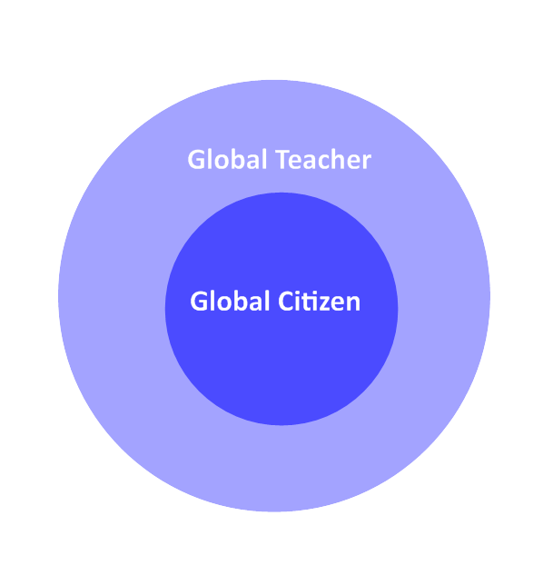
Global teacher
personal identity: global citizen
professional identity: global teacher

Slide 5
How to become a global teacher?
be a global citizen
+ (more)
Out of comfort zone in an international workplace

Slide 6
International workplace requirements
Into a zone of proximal development as
a teacher
attitude
skills
knowledge

Slide 7
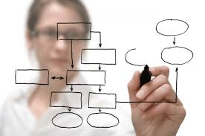
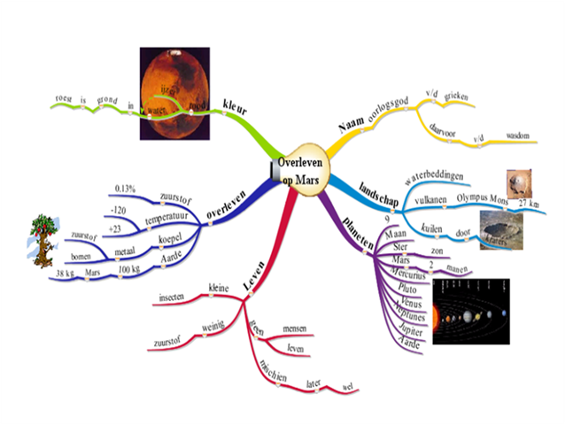

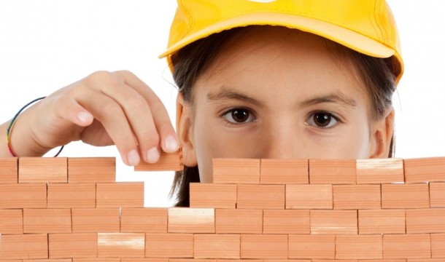

Question-driven learning
Phase 1 | Phase 2 | Phase 3 | Phase 4 | Phase 5
design | introduce | questioning | construct knowledge | evaluate
Core curriclum | Inventory of prior knowledge | elicit select c) answer | Construct collectieve knowledge | knowledge (meta) cognitive skills
Expert mind map | Classroom mind map | Classroom mind map | Classroom mind map | Classroom mind map
Teachers | Teachers Pupils | Teachers Pupils | Teachers Pupils | lTeachers Pupils
Notes:
question-driven learning can be seen as a 5 phase process
In this proces mind mapping is used to support teachers in designing, guiding and evaluating question driven learning
teachers design a core curriculum in an expert mind map which contains the most important key-concepts. The core curriculum is a conceptual focus to elicit student questioning and structure subsequent knowledge construction
in the second phase teachers introduce the theme to the pupils and make inventory of collective prior knowledge in their class by constructing a classroom mind map
Having explored the prior knowledge and interests about the theme, students are invented to raise their own questions by brainstorming in small groups, evaluating the quality of raised questions and adopting questions of their own choice. Subsequently pupils investigate their own questions (in dyads) en seek for answers either by using resources as the internet or books or interviewing experts, conducting an experiment etc
the answers to the student questions are the building blocks for constructing collective knowledge. Answers are exchanged, discussed and added to the classroom mindmap to visualize the collective knowledge construction
Finally mind mapping is used to evaluate learning outcomes, both collectively in the classroom mind map and individually in personal mind maps. Also meta cognitive skills can be evaluated by discussing which questions were effective for learning, which strategies were succcesful for answering and which skills were helpful in developing individual and collective knowledge

Slide 8


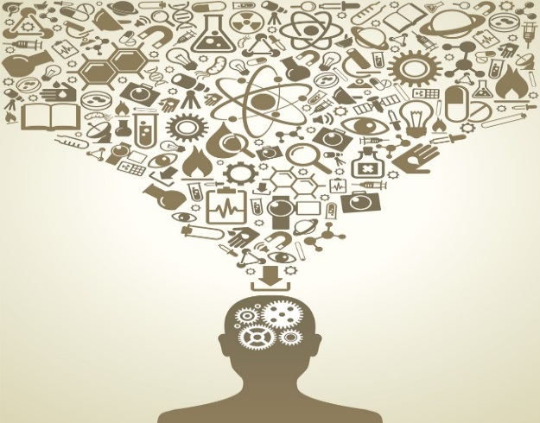
QDL supports global citizenship
Attitude
Skills
Knowledge

Slide 9
QDL supports global citizenship
Attitude
  inquiry as a stance
      open mindedness
          critical thinking
              life long learning

Slide 10
QDL supports global citizenship
Skills
    questioning
      inquiring
        planning
          cooperation
            presenting
              discussing

Slide 11
QDL supports global citizenship
Knowledge
  of other (cultural) perspectives
      awareness of own cultural identity

Slide 12
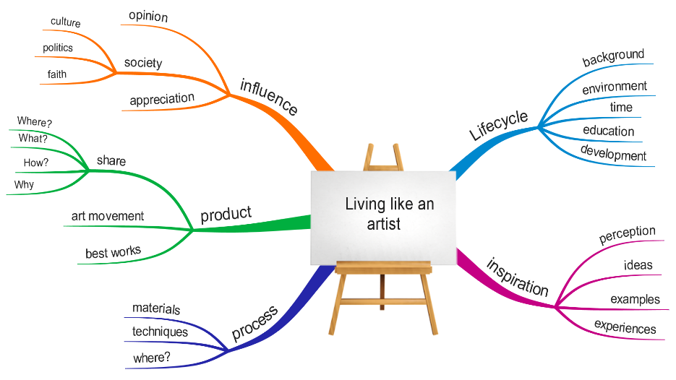
Workplace assignment Winter Course
Expert Mind Map “Living like an Artist”
Notes:
students select an Australian Artist and send this to the Netherlands
Dutch teacher introduce first the theme to pupils
Having explored the mindmap using Rembrandt as example
Students are allowed to explore artists of their liking
To imbed the coming of Australian students the previously selected Australian Artist are introduced to class
Pupils raise questions about these Australian Artist
Their questions are sent to the International students to prepare

Slide 13


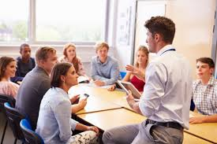
Multiple partners collaborating
International students
Pupils
(& teachers)
Faculty

Slide 14
Multiple partners collaborating
International students
select artist
prepare to guide pupil questions
support pupils to answer questions
support pupils to exchange answers and built knowledge

Slide 15
Multiple partners collaborating
Pupils (& teachers)
introduce artist in class
raise questions
investigate questions
exchange answers
built collective knowledge in classroom mindmap

Slide 16
Multiple partners collaborating
Faculty
introduce concept of QDL
support students for:
mind mapping
guiding questions
knowledge construction
support student reflection

Slide 17
Becoming global teachers: knowledge
This experience changed my idea of teaching from need to know all the answers, to co-inquire and co-construct knowledge with pupils.”
“Question-driven learning requires knowing what pupils’ interests are.”
“Making a mind map pushes you to think more in depth and push past mental boundaries”.

Slide 18
Becoming global teachers: skills
“It is possible to organize shared control of learning in which children and their interest are more involved”
The mind map was a good base to design activities and plan to suit interests”
“It maps out pupils’ ideas and where they and the teacher are heading for”
“Elaboration of classroom mind maps shows development of student learning”.

Slide 19
Becoming global teachers: attitude
“This experience dramatically changed my vision on my role as a teacher, I was a facilitator and guide to knowledge and tools”
“I have come to see how pupil-centered teaching allows pupils to feel valued and deepens the meaning of their learning”.
“I felt confident when pupils were engaged in their tasks….In this way, children are more prepared for life”.

Slide 20
“Let’s focus on exploration”

