Slide 1
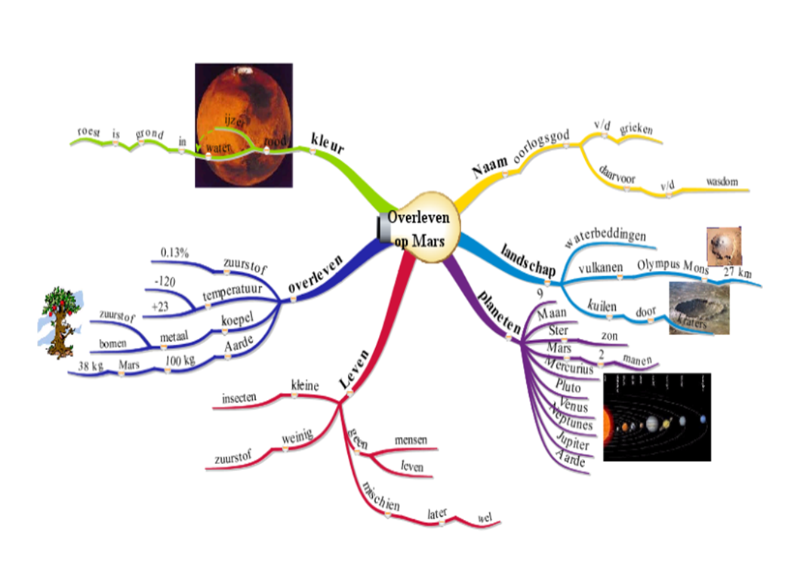
DYNAMIND
Supporting Question-Driven Learning
by Digital Mind Mapping
Harry Stokhof- HAN University
Bregje de Vries- HAN University
Theo Bastiaens- Open University
Rob Martens- Open University
Figure 1: student mind map grade 5

Slide 2
DYNAMIND
Importance of question- driven learning
Growing interest in role of students’ questions,
especially in context of the development of Science Education
(Centre for Science, 2000; High Level Group on Science Education, 2007).
Empiric evidence for the benefits of students’ questions:
increases intrinsic motivation for learning (Chin & Osborne, 2008; Deci & Ryan)
connects learning to prior knowledge (Palincsar & Brown, 1984)
stimulates deep and meaningful learning
(Rosenshine, Meister & Chapman, 1996).
fosters development of metacognitive strategies (Chin & Osborne, 2008 ; Scardamalia & Bereiter, 1992)
Question-driven Learning is a specific open form of Inquiry Learning
in which students formulate and investigate their own questions
(Chin & Chia, 2004; Scardamalia & Bereiter, 1992; Shodell, 1995; Wells, 2001).

Slide 3
DYNAMIND
Teachers and Question-driven Learning
Teachers are positieve about forms of Inquiry learning.
(Sikko, Lyngved & Pepin, 2012)
Implementation in schools meets challenges, despite benefits for teachers and students.
(Chin & Osborne, 2008)
Teachers seek balance between providing freedom for question articulation and responsibility to attain the curriculum.
(Brown, 1992; Rop, 2003; Wells, 2001)
Teachers need support in designing, coaching and evaluating Question-driven Learning
(Aguiar, Mortimer & Scott, 2009; Nardone & Lee, 2011; Polman, 2004 )

Slide 4
DYNAMIND
Digital Mind Mapping as support?
Can digital mind maps support the balance between question articulation and attainement of the curriculum in QDL?
To research this a Question-driven Scenario was developed for primary education: Dynamind (Dynamic Mind Mapping).
(Stokhof & De Vries, 2009; Stokhof, Sluijsmans, Vlokhoven & Peters, 2011)
Mind Map is a powerful tool to visualize and structure key concepts ,
easy to learn by students in primary education.
(Buzan & Buzan, 2007; Merchie, 2009)
Digital Mind Mapping: flexible, dynamic, more elaborate functionality.
(Stokhof, et al. 2011; Tergan, 2005)

Slide 5
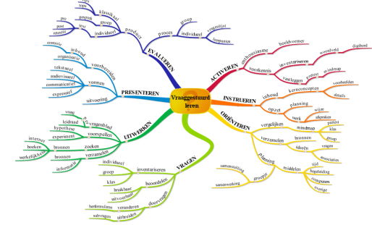
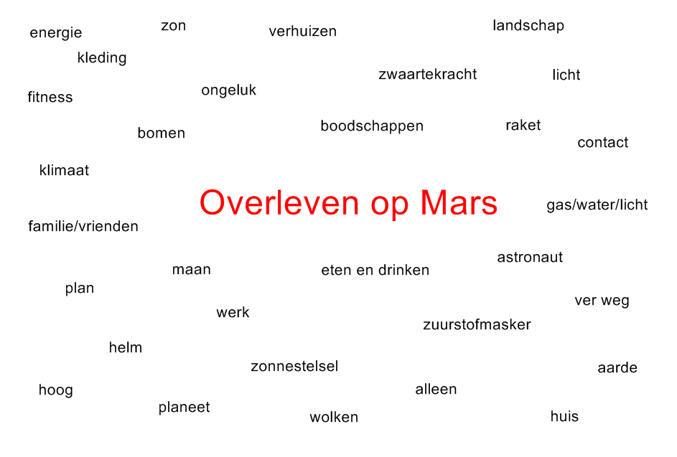
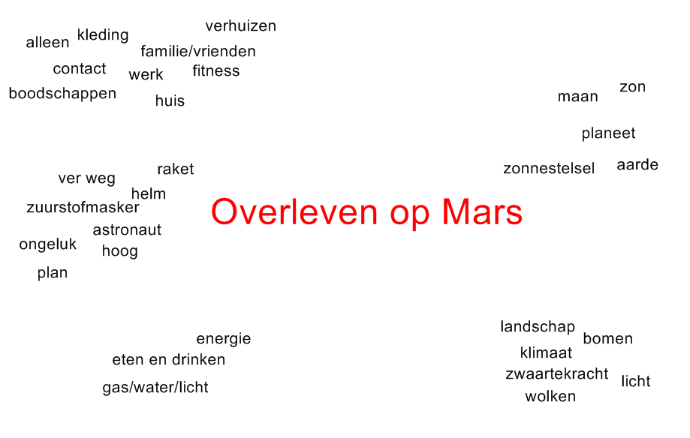
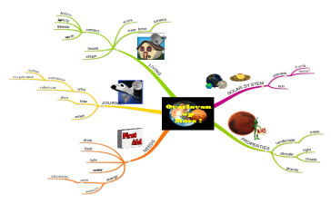
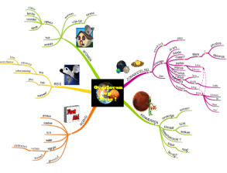
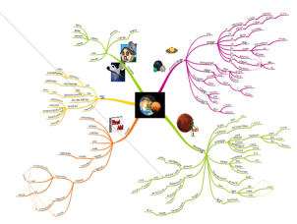
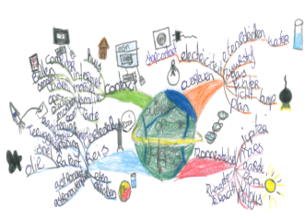
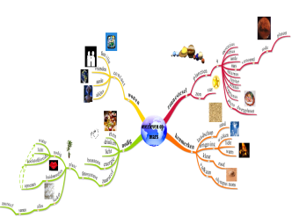
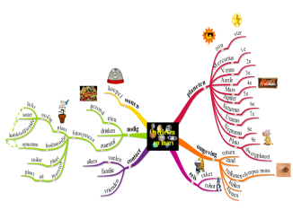
DYNAMIND
Four functions of digital mind mapping
design of core curriculum
activate & structure prior knowledge
word field
word cluster
classroom mind map
Core
Elaboration
Figure 3: teachers mind map
Figure 4: development classroom mind map
Design Teacher Mind Map as visualization of conceptual core curriculum
(vlg. Bereiter, 2004 ; Applebee, 1996)
Make inventory and structure prior knowledge by constructing a Classroom Mind Map
(Stokhof, et al., 2012)
generating & coaching questions
monitor & evaluate learning outcomes
classroom mind map 1
classroom mind map 2
classroom mind map 10
pre test
post test
retention test
Figure 5: elaboration of classroom mind map
Figure 6: mind map as assessment instrument
Connect questions to the classroom mind map.
Aim: coaching and exchanging questions and learning outcomes in a community of learners
(vgl. Scardamalia, 2002)
Evaluation of individual en collective cognitive development by mind map test & monitoring the development of the classroom mind map. (vgl. Brinkman, 2003)

Slide 6
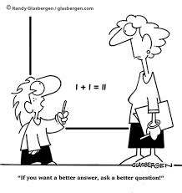
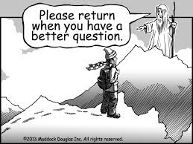
DYNAMIND
Research question
How can digital mindmapping enhance effective questioning behaviour and scaffold teachers' support of learners' questioning behaviour?

Slide 7
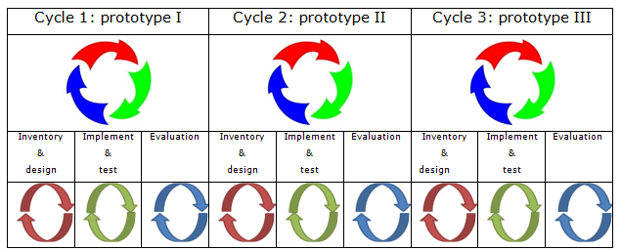
DYNAMIND
Method (1)
Design based reseach: repeated cycles of design, implementation and evaluation (McKenny & Reeves, 2012).
Participants: Grades 4-6 of two primary schools= 10 cases
Figure 7 : Cycli, prototypes and phases (adapted from McKenny & Reeves, 2012)
Notes:
(voorbeeld meenemen)

Slide 8
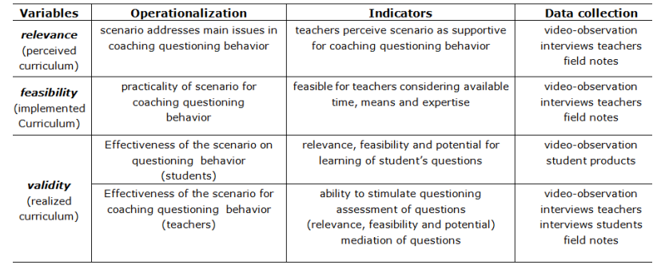
DYNAMIND
Method (2)
Table 1: variables, operationalization, indicators and data collection

Slide 9
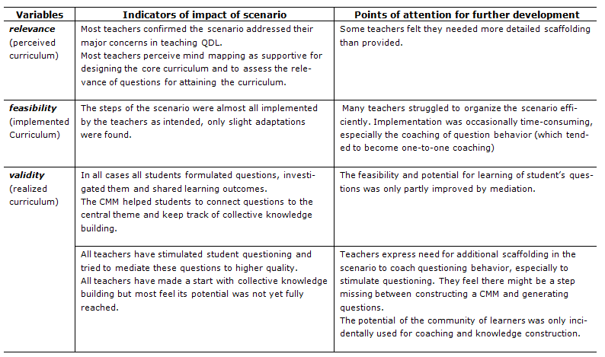
DYNAMIND
Preliminary findings

Slide 10
DYNAMIND
Design principle
The central design principle of the scenario is: “structured freedom”
The freedom to inquire into a topic of interest is balanced
by the visible structure of the core curriculum in the Classroom Mind Map,
to scaffold both individual and collective cognitive development.
Notes:
http://www.google.nl/imgres?hl=nl&biw=1280&bih=645&tbm=isch&tbnid=S_acNdZyJ6InEM:&imgrefurl=http://www.b-lay.com/2013/01/10/finding-your-software-balance/&docid=FiVjzePEj9sY9M&imgurl=http://www.b-lay.com/wp-content/uploads/2013/01/finding_balance_news_625x430.jpg&w=625&h=430&ei=DWiSUta7K4Tcswa634HYDA&zoom=1&ved=1t:3588,r:14,s:0,i:132&iact=rc&page=2&tbnh=176&tbnw=239&start=10&ndsp=21&tx=103.60009765625&ty=108.80000305175781

Slide 11
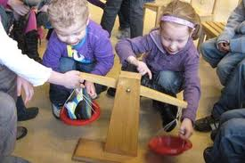
DYNAMIND
Discussing the scenario
Please take some time to scan through the hand-out of the scenario
and discuss in small groups :
What is the potential of mind mapping for establishing
“structured freedom”in to the Question-driven Classroom?
Notes:
http://www.google.nl/url?sa=i&rct=j&q=&esrc=s&frm=1&source=images&cd=&cad=rja&docid=oAN0tJfG56Gl0M&tbnid=Ev1bn5_Y5Wcy3M:&ved=0CAUQjRw&url=http%3A%2F%2Fwww.toevalgezocht.nl%2Fprojecten%2Fcultura_familia_i_project_van_een_jaar%2Fbeeldverslag%2F7845&ei=2WeSUorAKeiw0QWO3IDYDg&bvm=bv.57127890,d.Yms&psig=AFQjCNGSzqLneteEmsFEzAzh78lcNFm8jQ&ust=1385412943135713

