Slide 1
To Adopt, Adapt or Reject? Testing a scenario for guiding “effective student questioning”
EAPRIL present and discuss session
Harry Stokhof, Bregje de Vries, Theo Bastiaens, & Rob Martens

Slide 2
Need for effective student questioning
student questioning: multiple benefits for
learning
teaching
however
teacher questioning dominant
stiffles student questioning
main concern: curriculum objectives
Need for support for guidance effective student questioning
freedom for student questions
contribute to curricular objectives
Notes:
drie lagen over elkaar heen
eerst benefits
probleem
need for support

Slide 3
Support: Principle-based scenario
design-based research
collaboration practitioners
4 years
3 studies
literature review
development study
effectiveness study
4 (design) principles
question
potential
conceptual
focus
collective
responsibility
visual
support

Slide 4
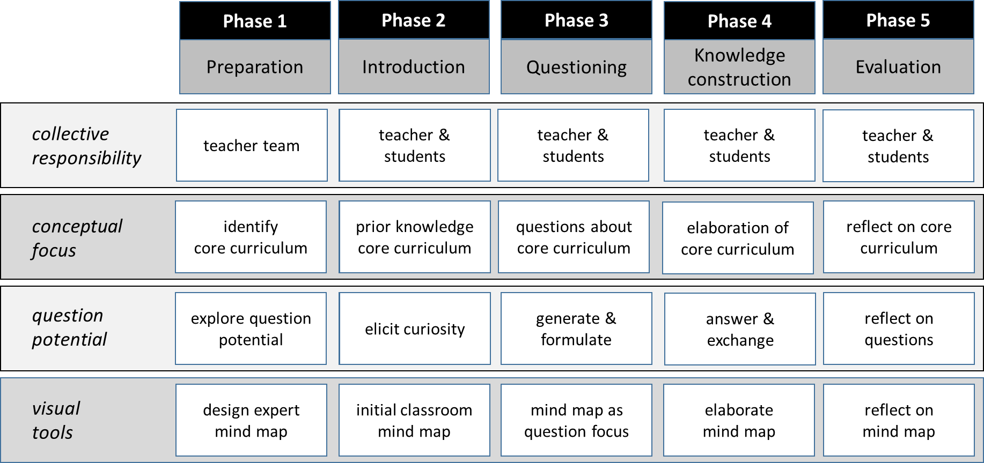
Design principles in 5 Phases of guidance

Slide 5
Robustness of scenario?
developed in two schools
collaboration with practioners
period of 4 years
succesful in these settings
but……transfer to different
settings?
teachers?
What is the robustness of a principle-based scenario for guiding effective student questioning?
?
?
?
?
?
Notes:
afbeeldingen verkregen op 1-11-2017 van:
http://www.vriendenvangorazde.com/school/eerste-bericht-over-school-2/
https://nl.pinterest.com/pin/440086194821038230/?lp=true
https://pixabay.com/nl/school-gebouw-onderwijs-295210/
http://www.wijchensnieuws.nl/pvda-wijchen-kinderen-met-beperking-zoveel-mogelijk-dichtbij-naar-school/
https://nl.pinterest.com/pin/440086194821038230/?lp=true
https://thetomatos.com/free-clipart-37384/
leraren
http://www.ignitumtoday.com/2011/10/27/agree-to-disagree/teacher-with-apple-clipart/
http://thejosevilson.com/fellow-male-educators-color/
http://weclipart.com/elementary+school+teacher+clip+art

Slide 6
Method: implementation research
Independent variable:
- trial of scenario: intended curriculum (van den Akker, 2003)
Dependent variables:
perceived curriculum: attributes of innovations (Rogers, 2003)
operational curriculum: activities in scenario (Stokhof et al., 2017)
realized curriculum: experience of guidance (Deci & Ryan, 2000)
implementation decision (Rogers, 2003; Fishbein & Ajzen, 2010)

Slide 7
Procedure
train-the-trainer
hands-on experience
rationale
various examples
introduce scenario
2 preparatory sessions
6 week trial
evaluation

Slide 8
Population
23 schools
rural-urban setting
size student population
size teacher team
school vision
curriculum materials
curriculum organisation
single- combined grades
% special care students
103 teachers
age
gender
grade
general experience
experience IBL
experience co-design
experience mind mapping
motivation
perceived support school leader
perceived support trainer

Slide 9
Data collection
Instruments | (Co-)Variables | Based upon
Questionnaire | Perceived curriculum | Rogers (2003), Stachewitz (2011)
 | Operational curriculum | Stokhof et al. (2017)
 | Realized curriculum | Deci et al. (2001)
 | Implementation decision | Rogers (2003)
 | Teacher characteristics | Ellsworth (2000), Fullan and St.Germain (2006)
Product collection | Operational curriculum | Stokhof et al. (2017)
School documents Consultation trainers | School characteristics | Ellsworth (2000), Hargreaves and Fullan (2014), Ryan and Deci (2000)

Slide 10
Analysis
Step 1:
implementation decision?
Step 2:
perceived curriculum?
Step 3:
operational curriculum?
Stap 4:
realized curriculum?
Step 5:
correlating variables?
Scores < 30% likeliness = reject =50% likeliness = in doubt >70% likeliness = adopt | Scores 7-point Likert sum scores reliability analysis | Scores Activities Dichotomous essential/optional | Scores 7-point Likert sum score reliability analysis | Spearman’s ρ perceived curriculum operational curriculum realized curriculum
Frequencies each phase overall | Frequencies each phase each attribute | Frequencies each phase total | Frequencies each phase each indicator | Spearman’s ρ school characteristics teacher characteristics
 |  | Triangulation product collection

Slide 11
Results implementation decision
Phase | Decision: reject (0-30% likely to adopt) | Decision: in doubt (50% likely to adopt) | Decision: adopt (70%- 100% likely to adopt)
1: preparation | 4,8% | 14.2% | 81.0%
2: introduction | 7.1% | 9.5% | 83.4%
3: questioning | 3.6% | 9.5% | 86.9%
4: construction | 10.7% | 13.1% | 76.2%
5: evaluation | 14.3% | 15.5% | 70.2%
Overall score | 10.7% | 13.1% | 76.2%

Slide 12
Results: correlations with (co-)variables
Experienced curriculum
autonomy
competence
relatedness
overall
Perceived curriculum
relative advantage
compatibility
observability
complexity
trialibility
.567
.571
.626
.497
.437
Implementation decision
.576
.624
.543
.528
School characteristics (2 of 8)
single vs combined grades
size schoolteam
-.250
.223
.309
.625
Operational curriculum (3 of 5)
Phase 2: Introduction
Phase 4: Construction
Phase 5: Evaluation
Teacher characteristics (3 of 10)
motivation for student questioning
perceived support leader
perceived support trainer
.479
.294
.497
.462

Slide 13
Conclusion
scenario is robust
diversity of teachers is
appreciative
willing
generally independent of
school characteristics
teacher characteristics

Slide 14
Discussion: explanations for relative success?
Cultural disposition of teachers
volunteer sample
prevailing culture in the Netherlands
Felt need…
sense of urgency (Fullan, 2006; Kotter, 1998)
Type of innovation
designed for and by teachers
principle-based
flexible and adaptable

Slide 15
Question/statement?
Successful implementation requires an educational design that is
principle-based rather than highly scripted

